Slide 1
Raster-to-Graph: Floorplan Recognition via Autoregressive Graph Prediction with an Attention Transformer
Sizhe Hu Wenming Wu Ruolin Su
Wanni Hou Liping Zheng Benzhu Xu
Sizhe Hu: First Author, Main Contributor and Presenter
23.04.2024

Slide 2

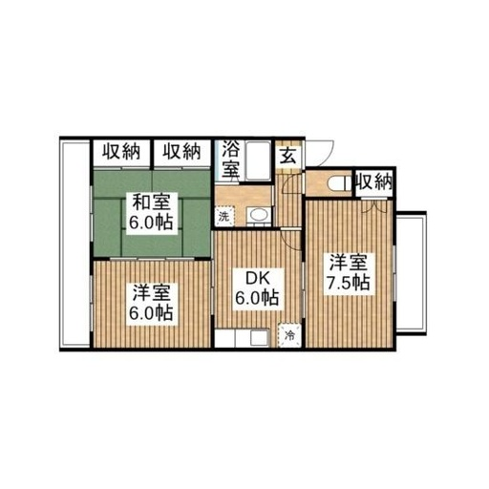

Floorplan Recognition
Closet
Bathroom
Some Doors
Balcony
Some Rooms
Bedroom

Slide 3

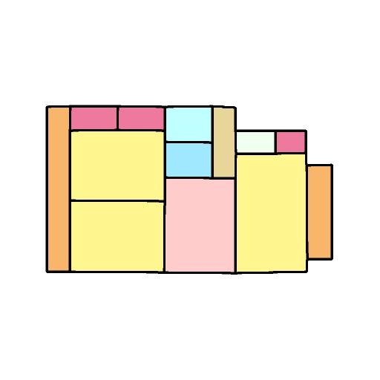

Floorplan Recognition
Recognition
Raster Floorplan Image
Vector Floorplan Graphic

Slide 4
Floorplan Recognition
Living Room
Kitchen
Bedroom
Bathroom
Restroom
Balcony
Closet
Corridor
Washing-room
Pipe-space
Unknown
Floorplan Recognition

Slide 5

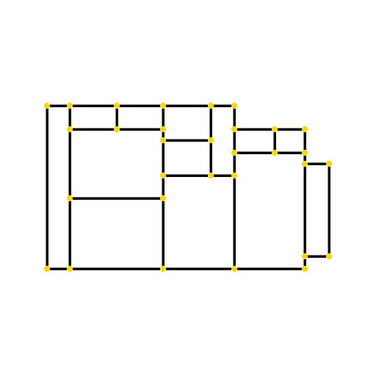
Existing Methods
Semantic Recognition
Structure Reconstruction

Slide 6
Existing Methods
Semantic-Structure Recognition

Slide 7
Our Method
Semantic-Structure Recognition
via Graph Prediction

Slide 8
Our Method
Recognition
Graph Prediction
Recognition

Slide 9
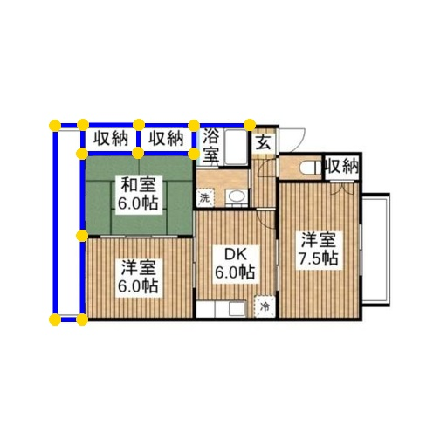
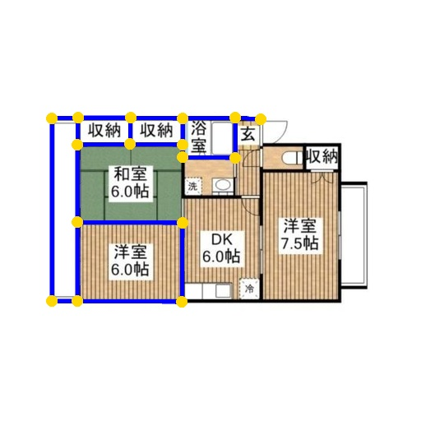
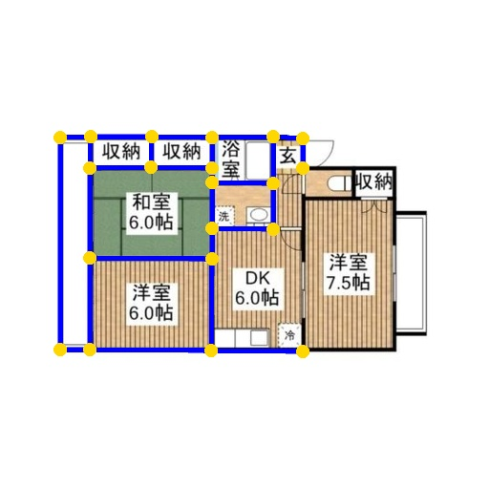
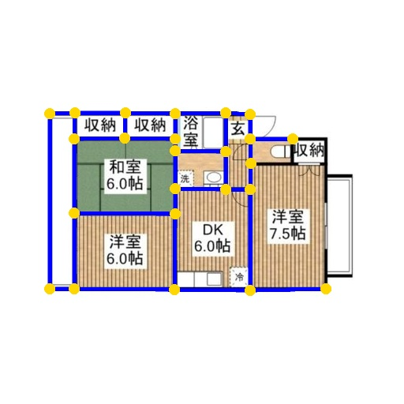

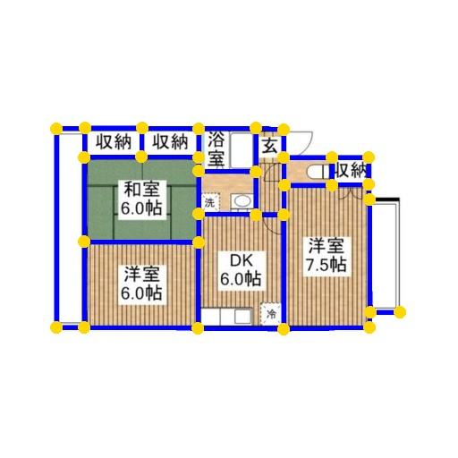
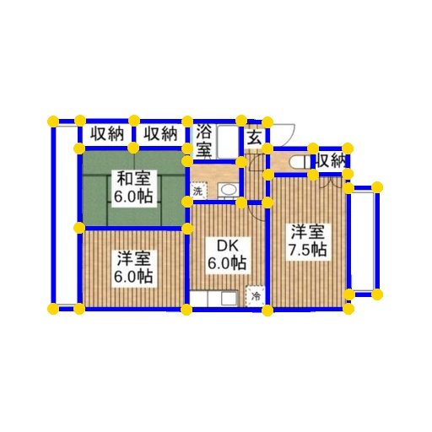

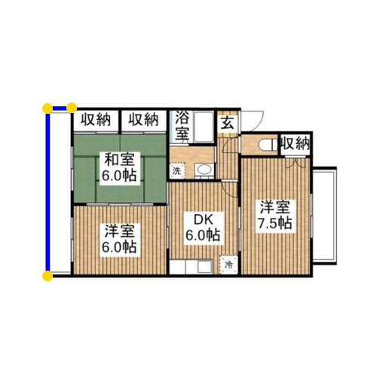
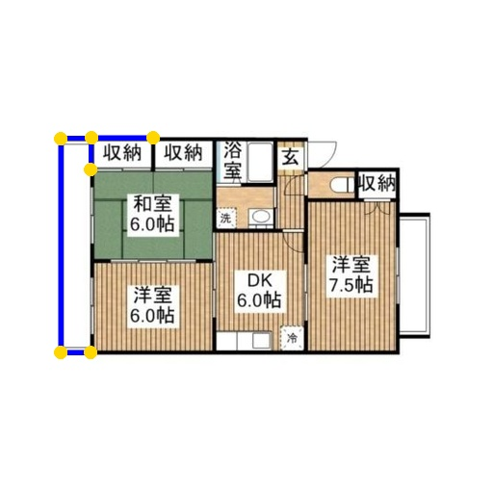

Our Method: Raster-to-Graph
Overview

Slide 10
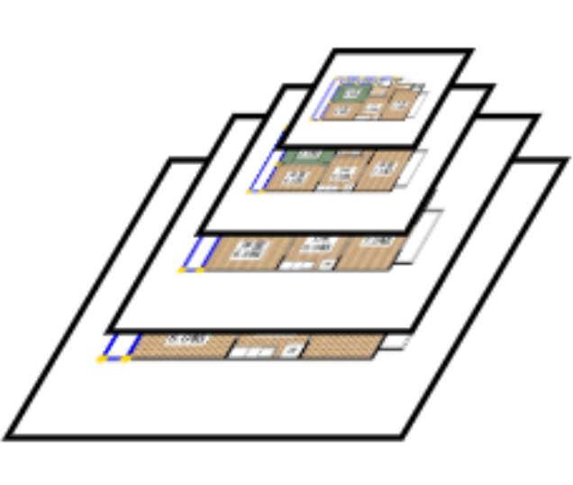
Our Method: Raster-to-Graph
FFN
Coo
r
dina
t
ResNet
e
FFN
Node type
FFN
In
t
e
r
-la
y
er connection
FFN
Intra-la
y
er connection
FFN
T
op-le
f
t
r
oom ca
t
ego
r
y
FFN
T
op-right
r
oom ca
t
ego
r
y
…
…
FFN
Bot
t
om-le
f
t
r
oom ca
t
ego
r
y
FFN
Bot
t
om-right
r
oom ca
t
ego
r
y
Node Prediction
A
ttribu
t
es

Slide 11
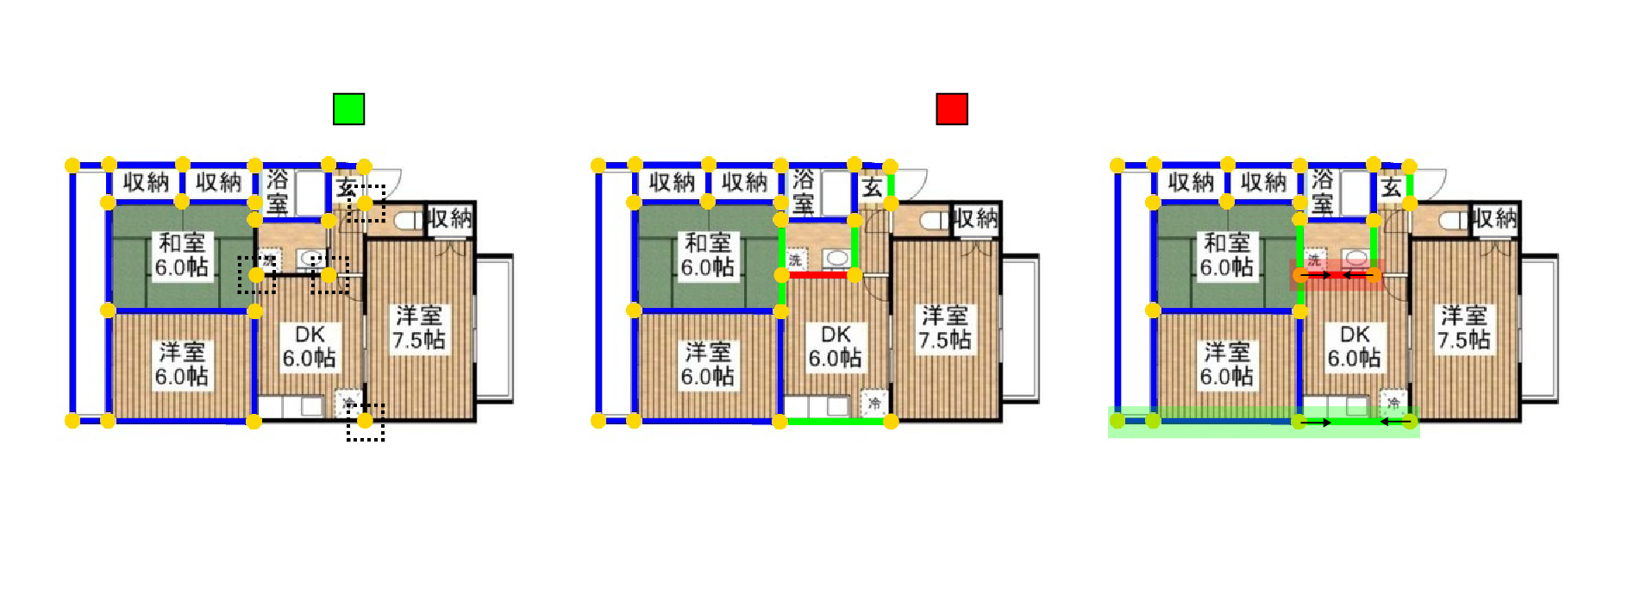
Our Method: Raster-to-Graph
Inter-level connection
Intra-level connection
Graph Construction

Slide 12
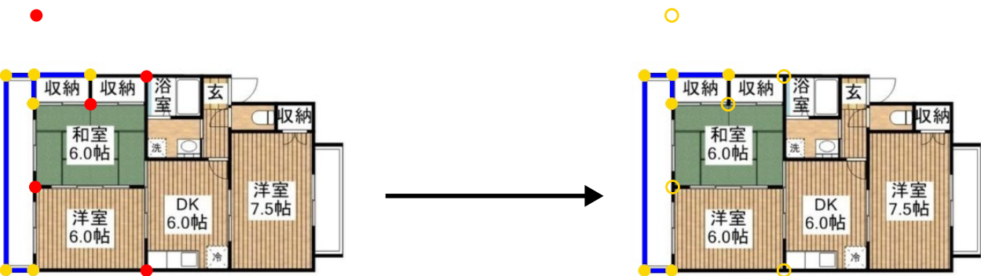
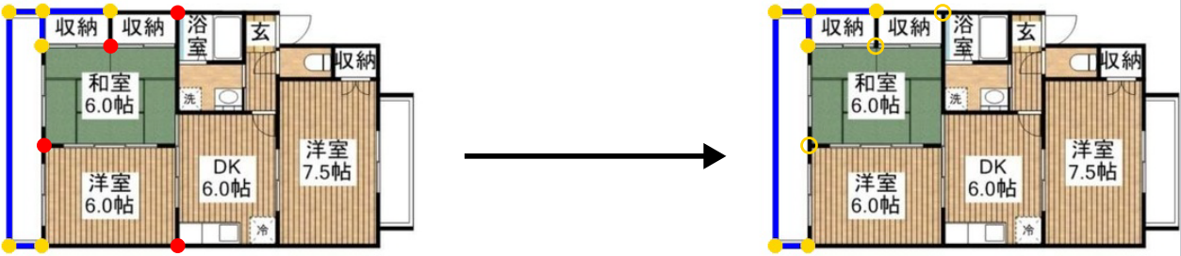
Our Method: Raster-to-Graph
Neighborhood nodes
Sampled nodes
Breadth First Traversal
Our Graph Traversal
Training Strategy

Slide 13
Ablation Studies
Autoregression/
Non-Autoregression
Raster-to-Graph
Sample Probability

Slide 14
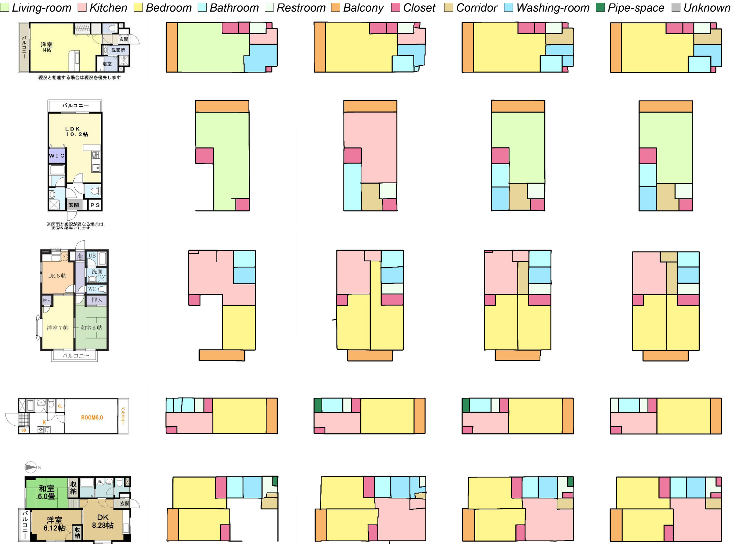
(a) Input
(b) R2G-NA
(c) R2G-DS
(d) R2G (Ours)
(e) Dataset

Slide 15
(a) Input
(b) R2G-NA
(c) R2G-DS
(d) R2G (Ours)
(e) Dataset

Slide 16
(a) Input
(b) R2G-NA
(c) R2G-DS
(d) R2G (Ours)
(e) Dataset

Slide 17
Contrastive Results
Structure Reconstruction
Raster-to-Graph
Semantic Recognition

Slide 18
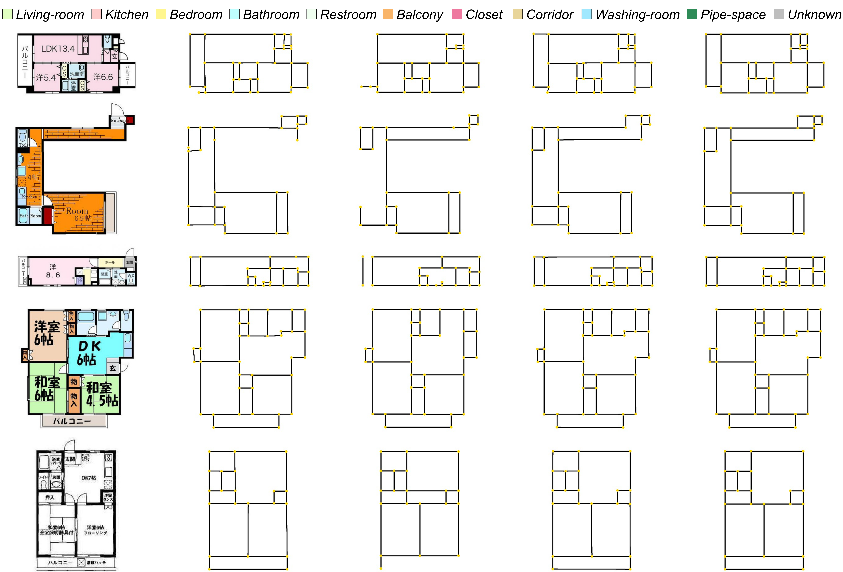
(a) Input
(b) HEAT
(c) R2V
(d) R2G (Ours)
(e) Dataset

Slide 19
(a) Input
(b) HEAT
(c) R2V
(d) R2G (Ours)
(e) Dataset

Slide 20
(a) Input
(b) HEAT
(c) R2V
(d) R2G (Ours)
(e) Dataset

Slide 21
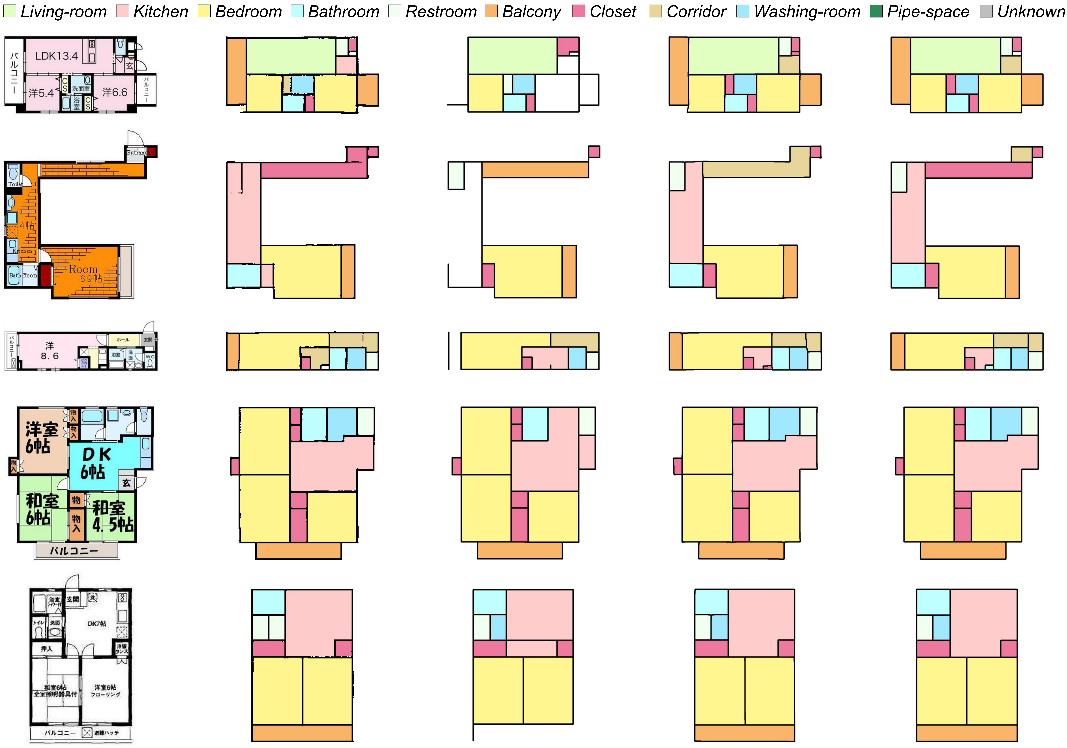
(a) Input
(b) DFPR
(c) R2V
(d) R2G (Ours)
(e) Dataset

Slide 22
(a) Input
(b) DFPR
(c) R2V
(d) R2G (Ours)
(e) Dataset

Slide 23
(a) Input
(b) DFPR
(c) R2V
(d) R2G (Ours)
(e) Dataset

Slide 24
Experimental results

Slide 25
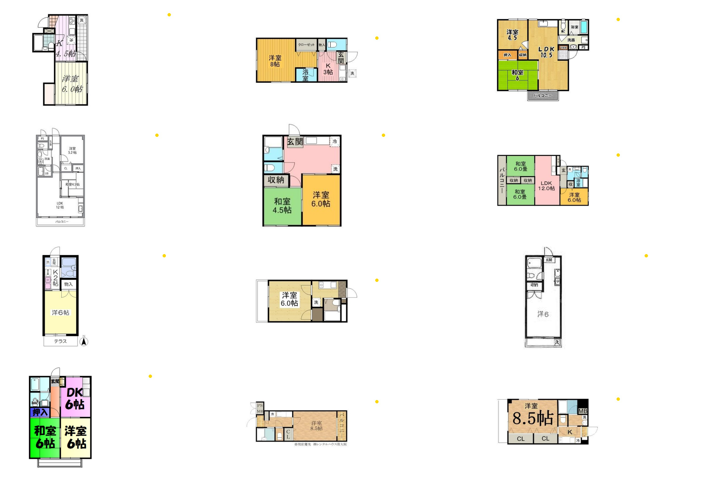

Slide 26
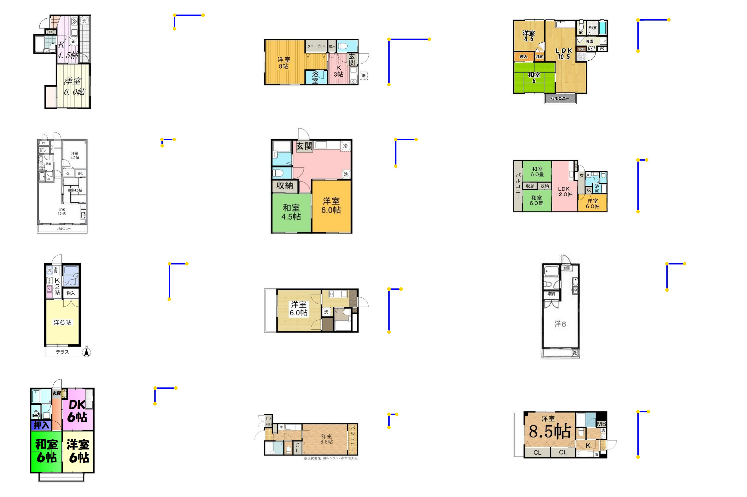

Slide 27
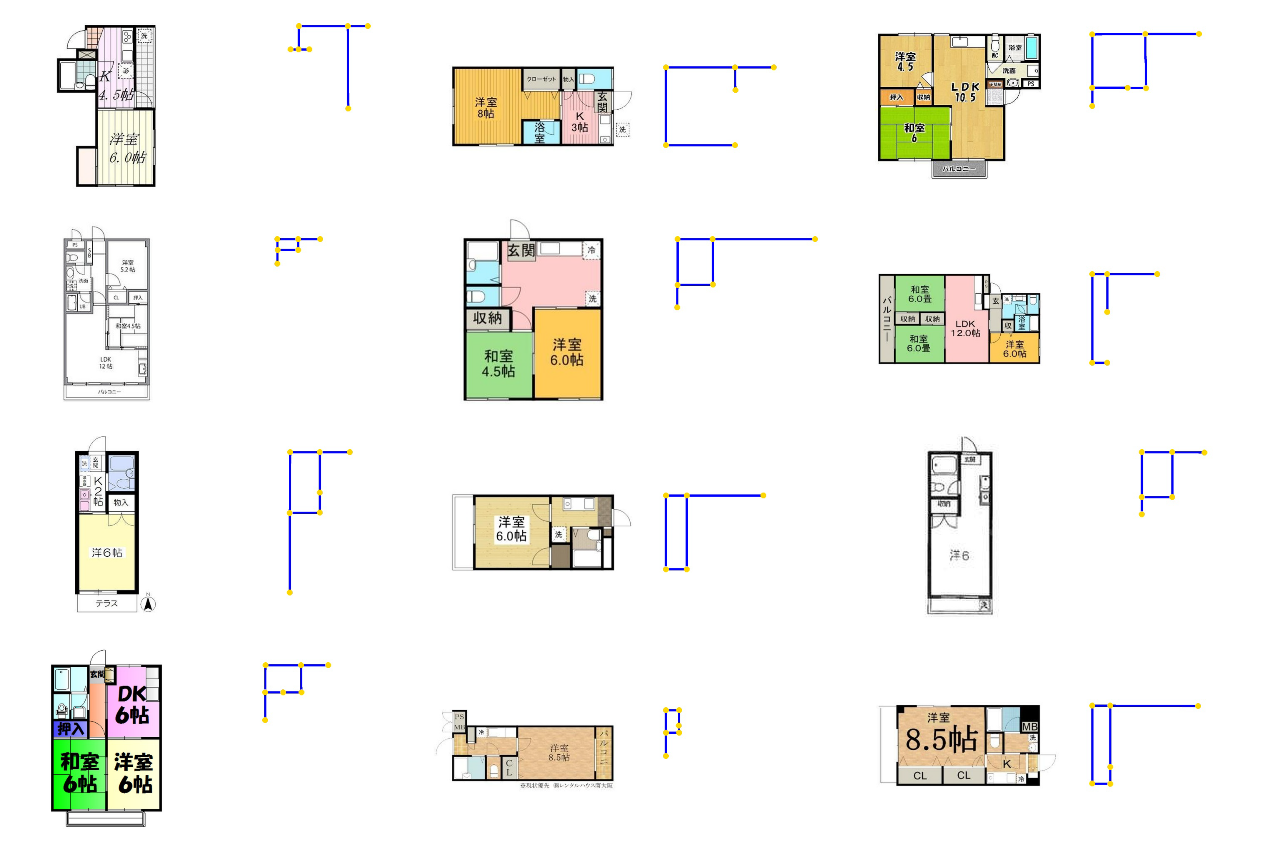

Slide 28
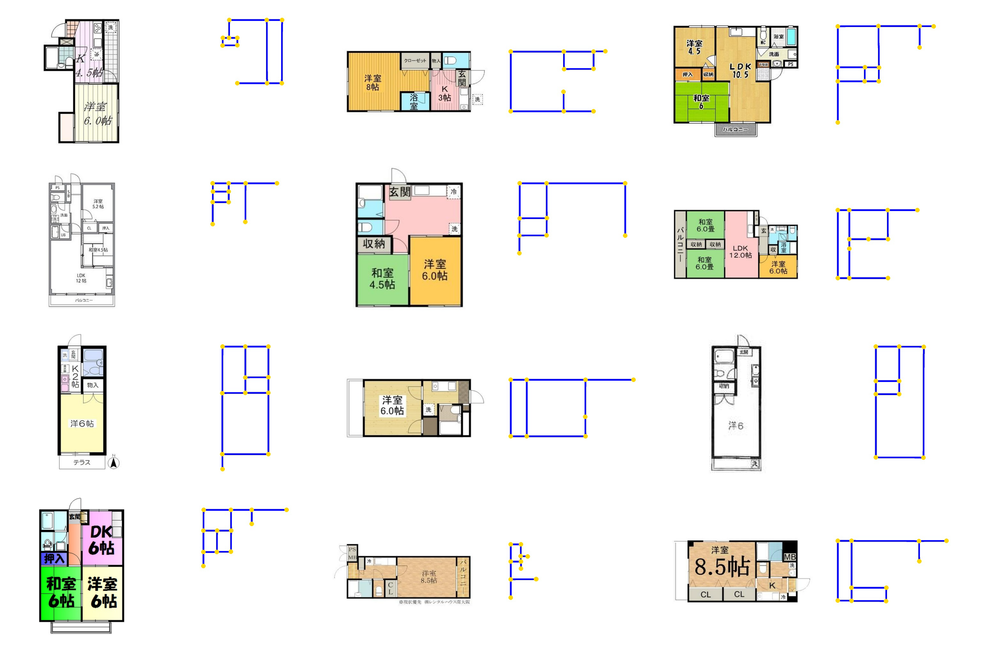

Slide 29
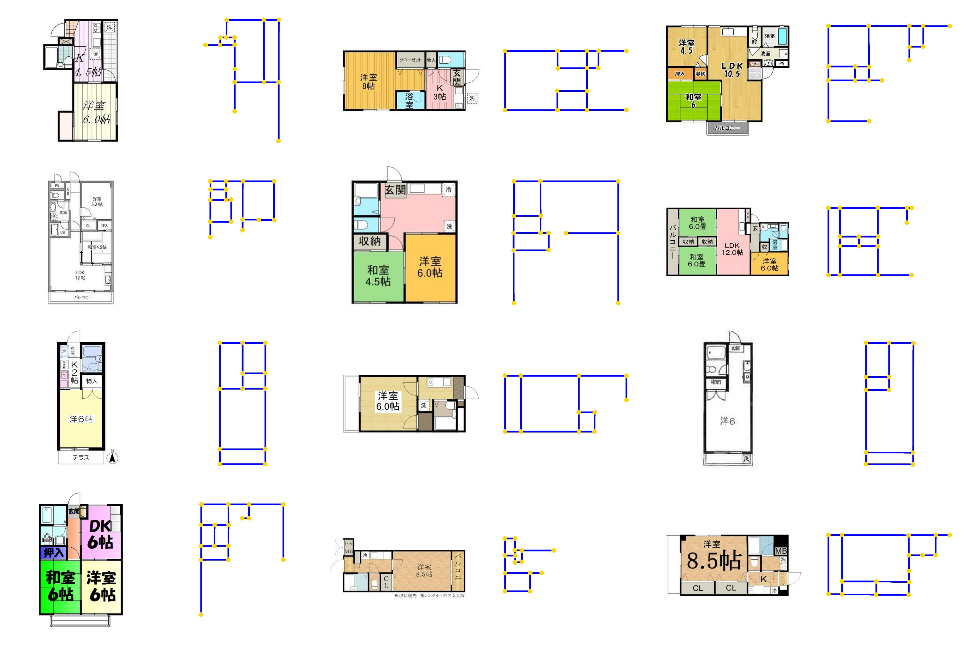

Slide 30
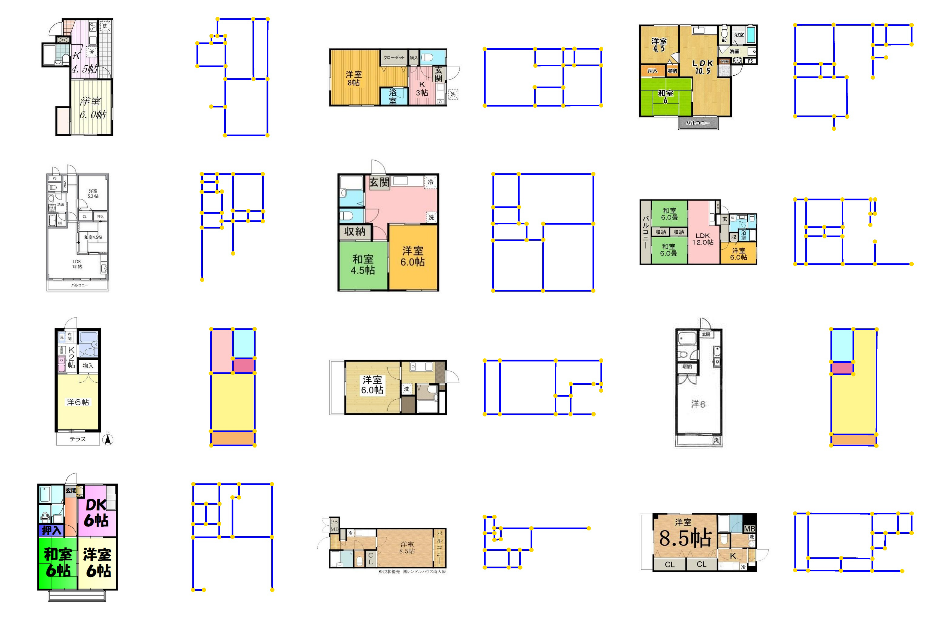

Slide 31
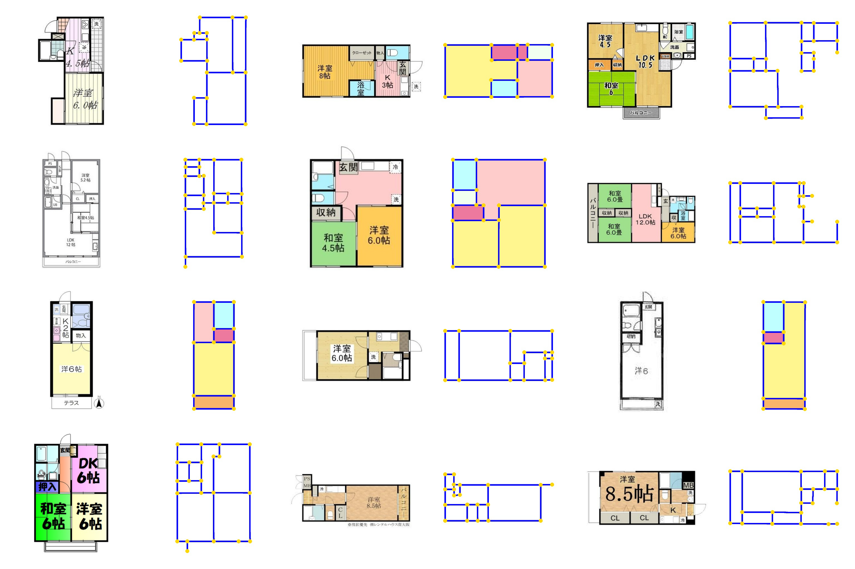

Slide 32
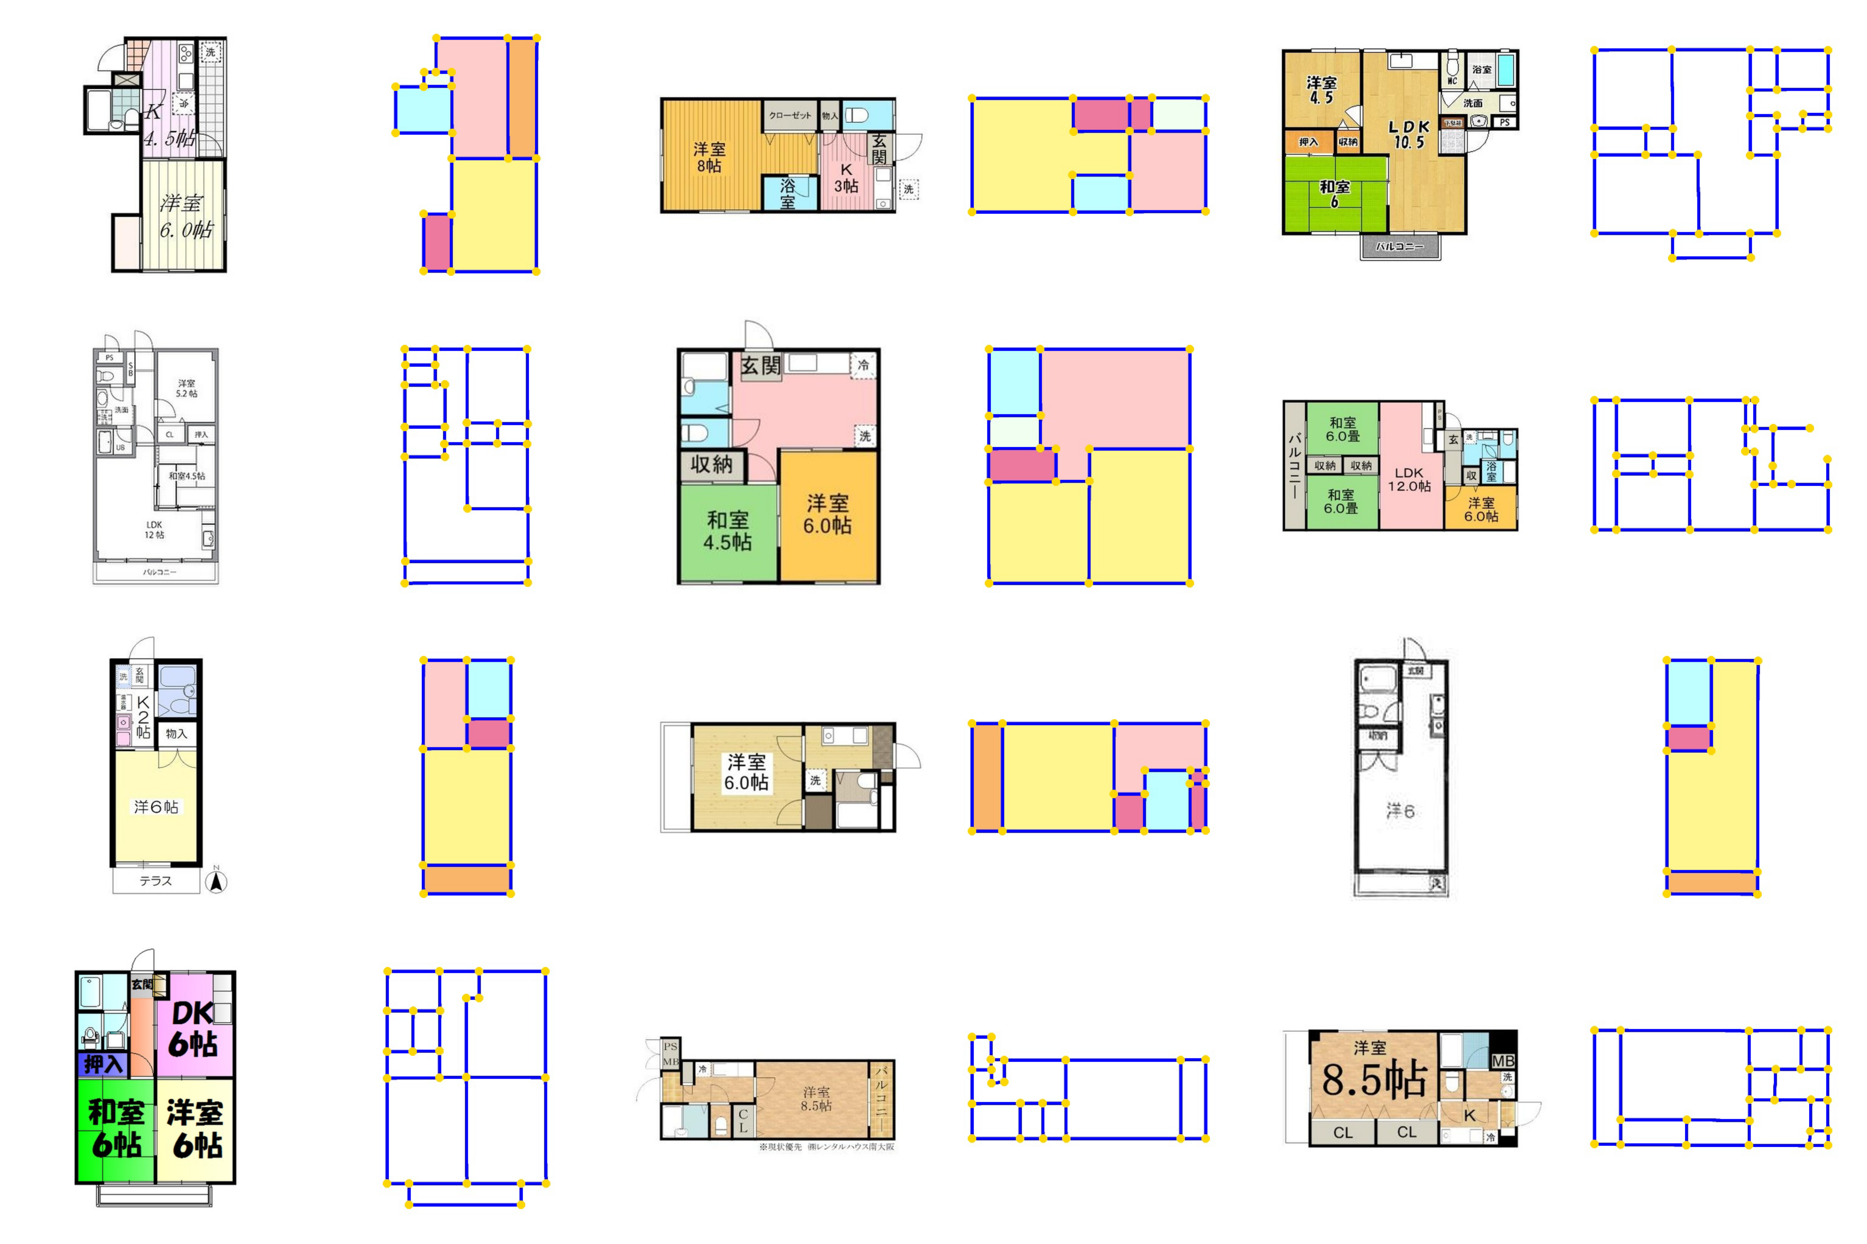

Slide 33
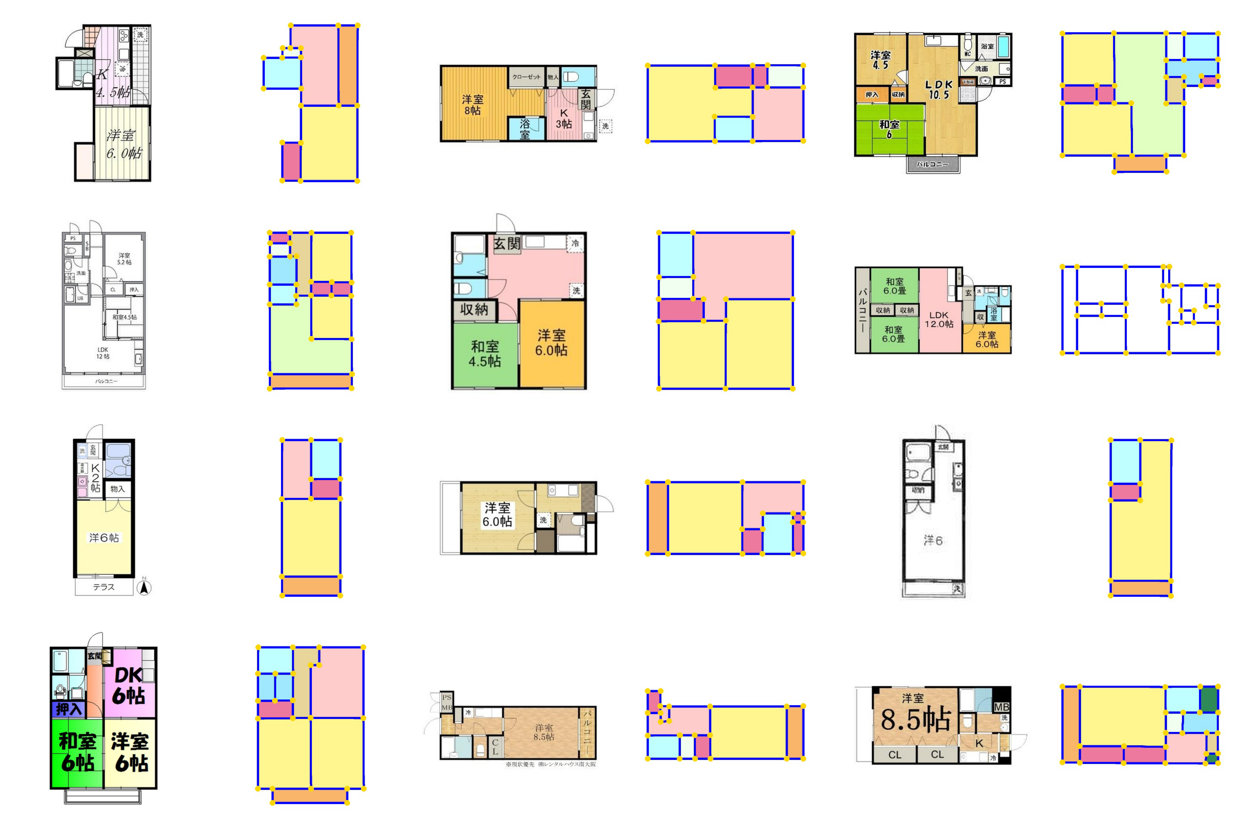

Slide 34
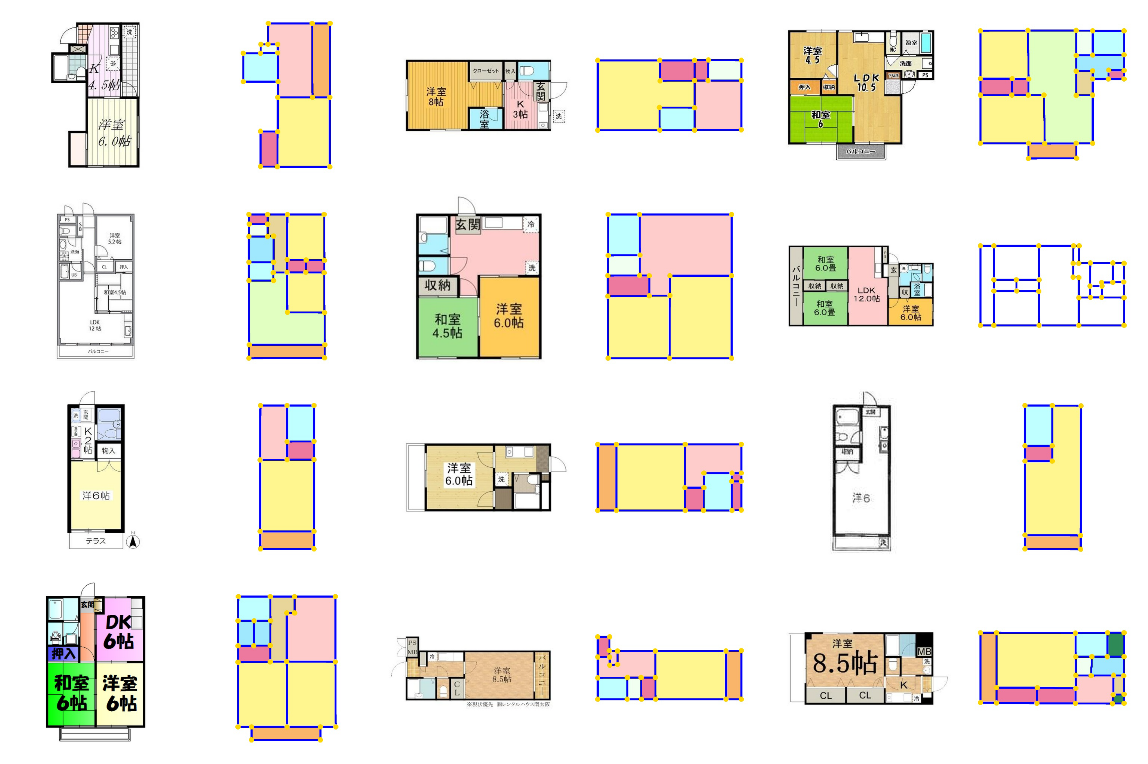

Slide 35
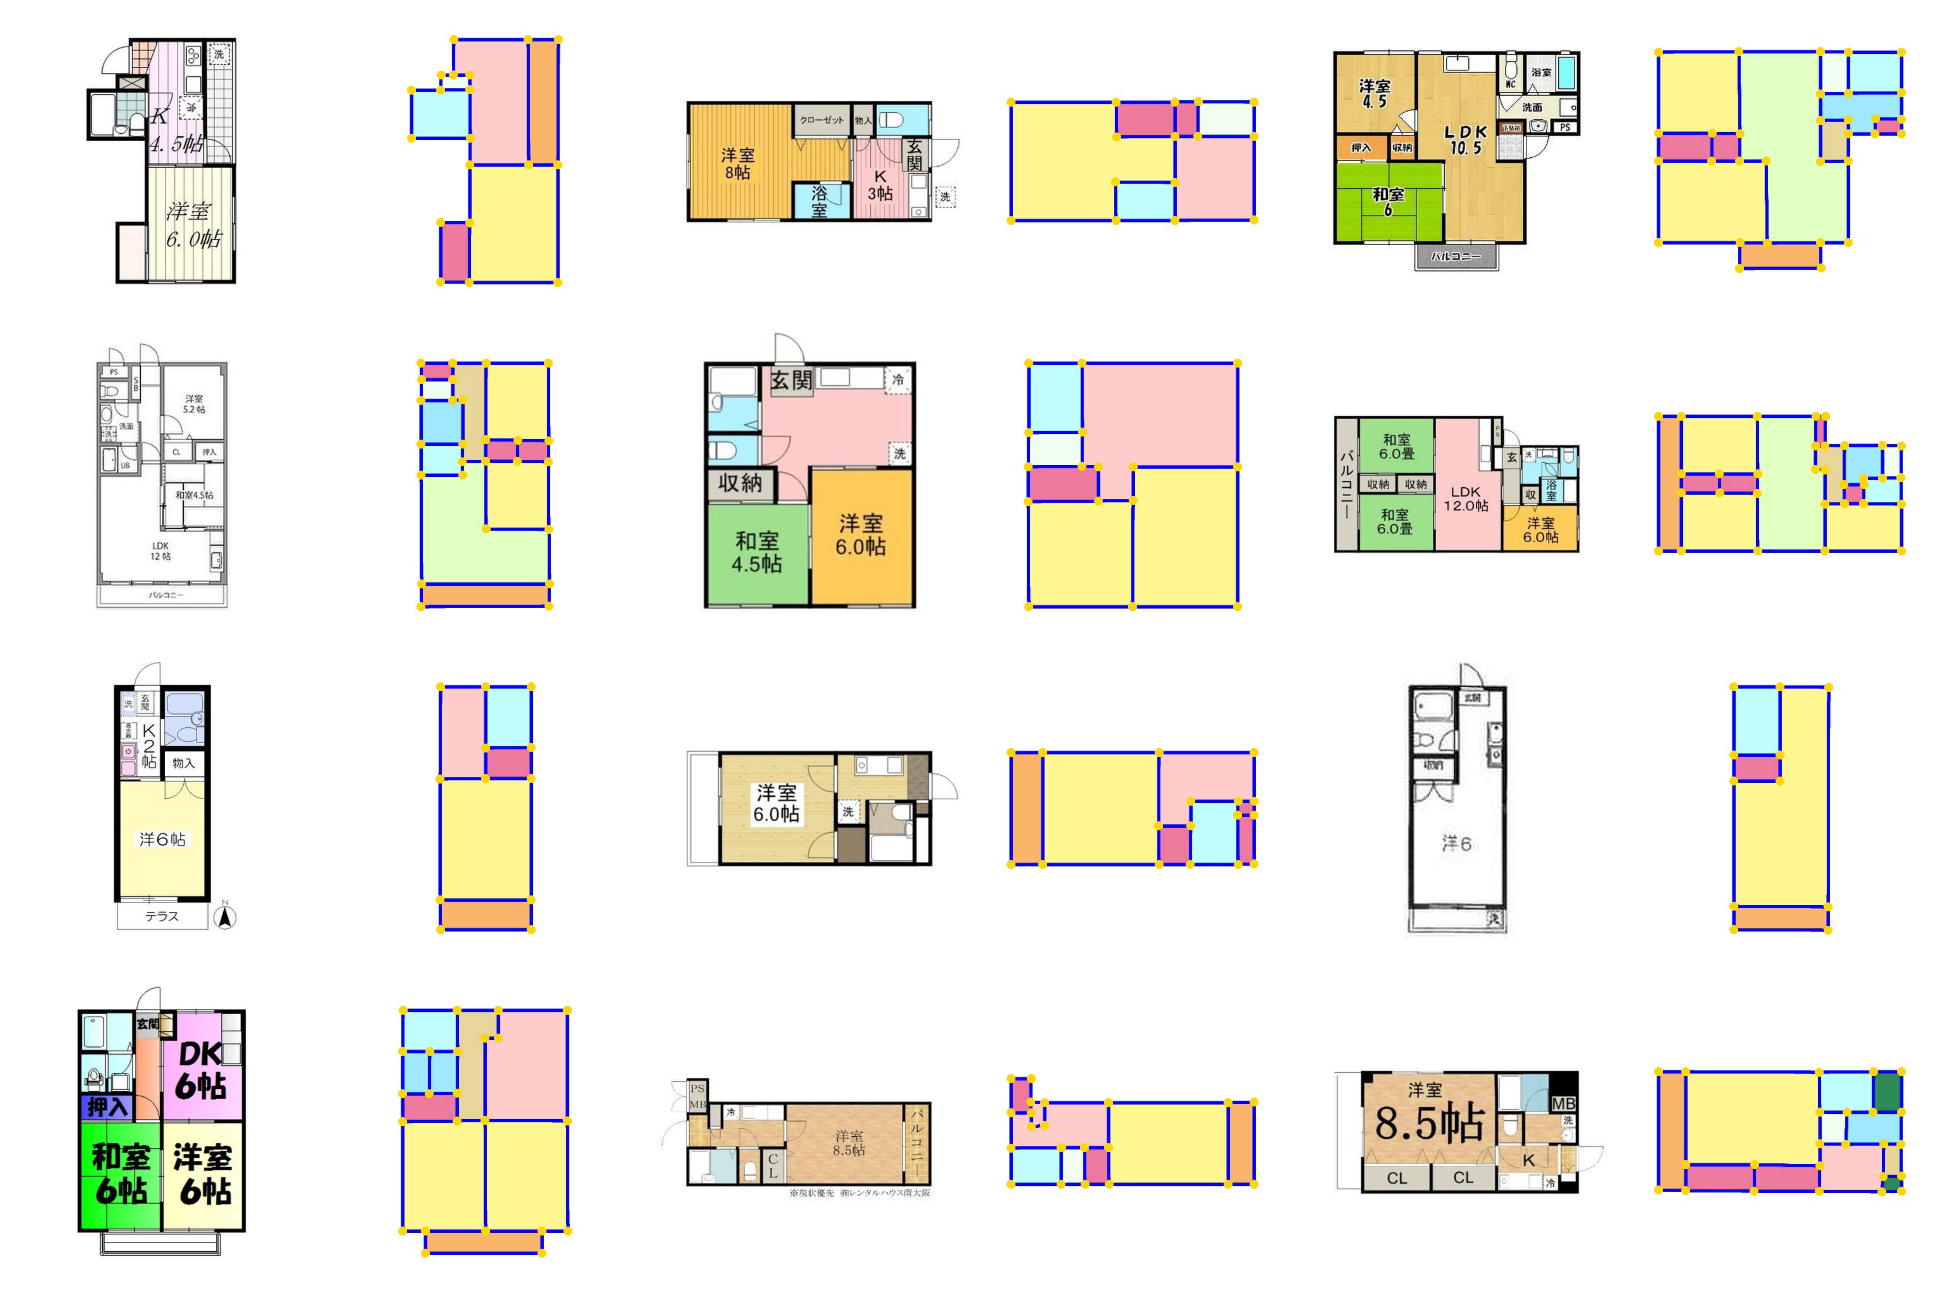

Slide 36
More results

Slide 37
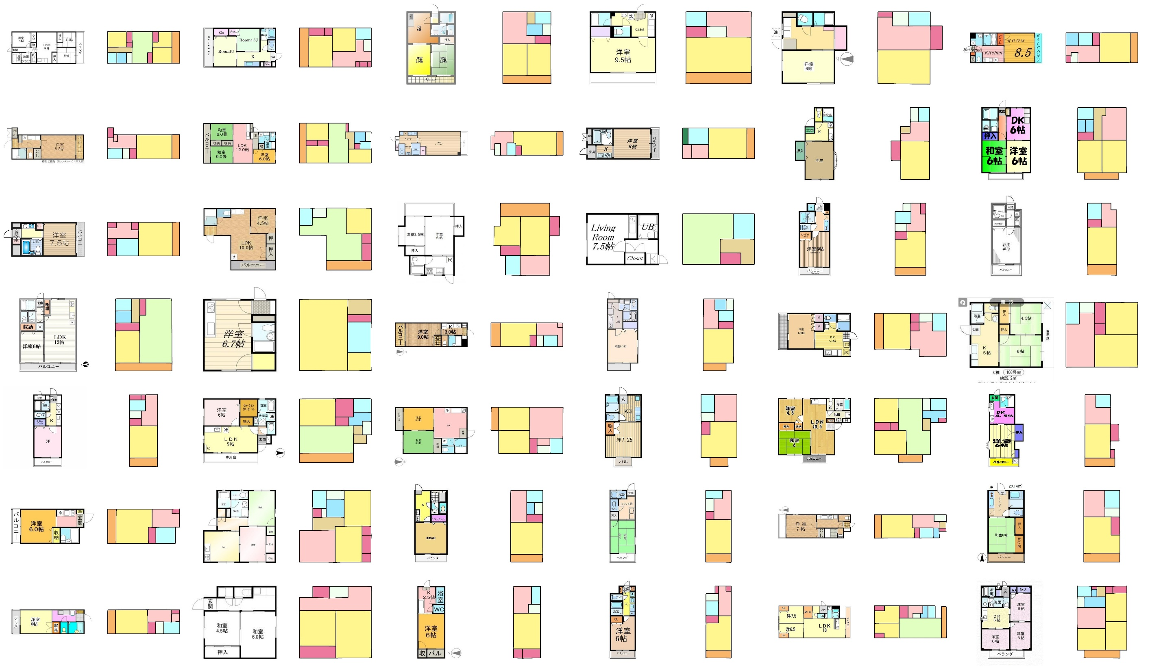

Slide 38
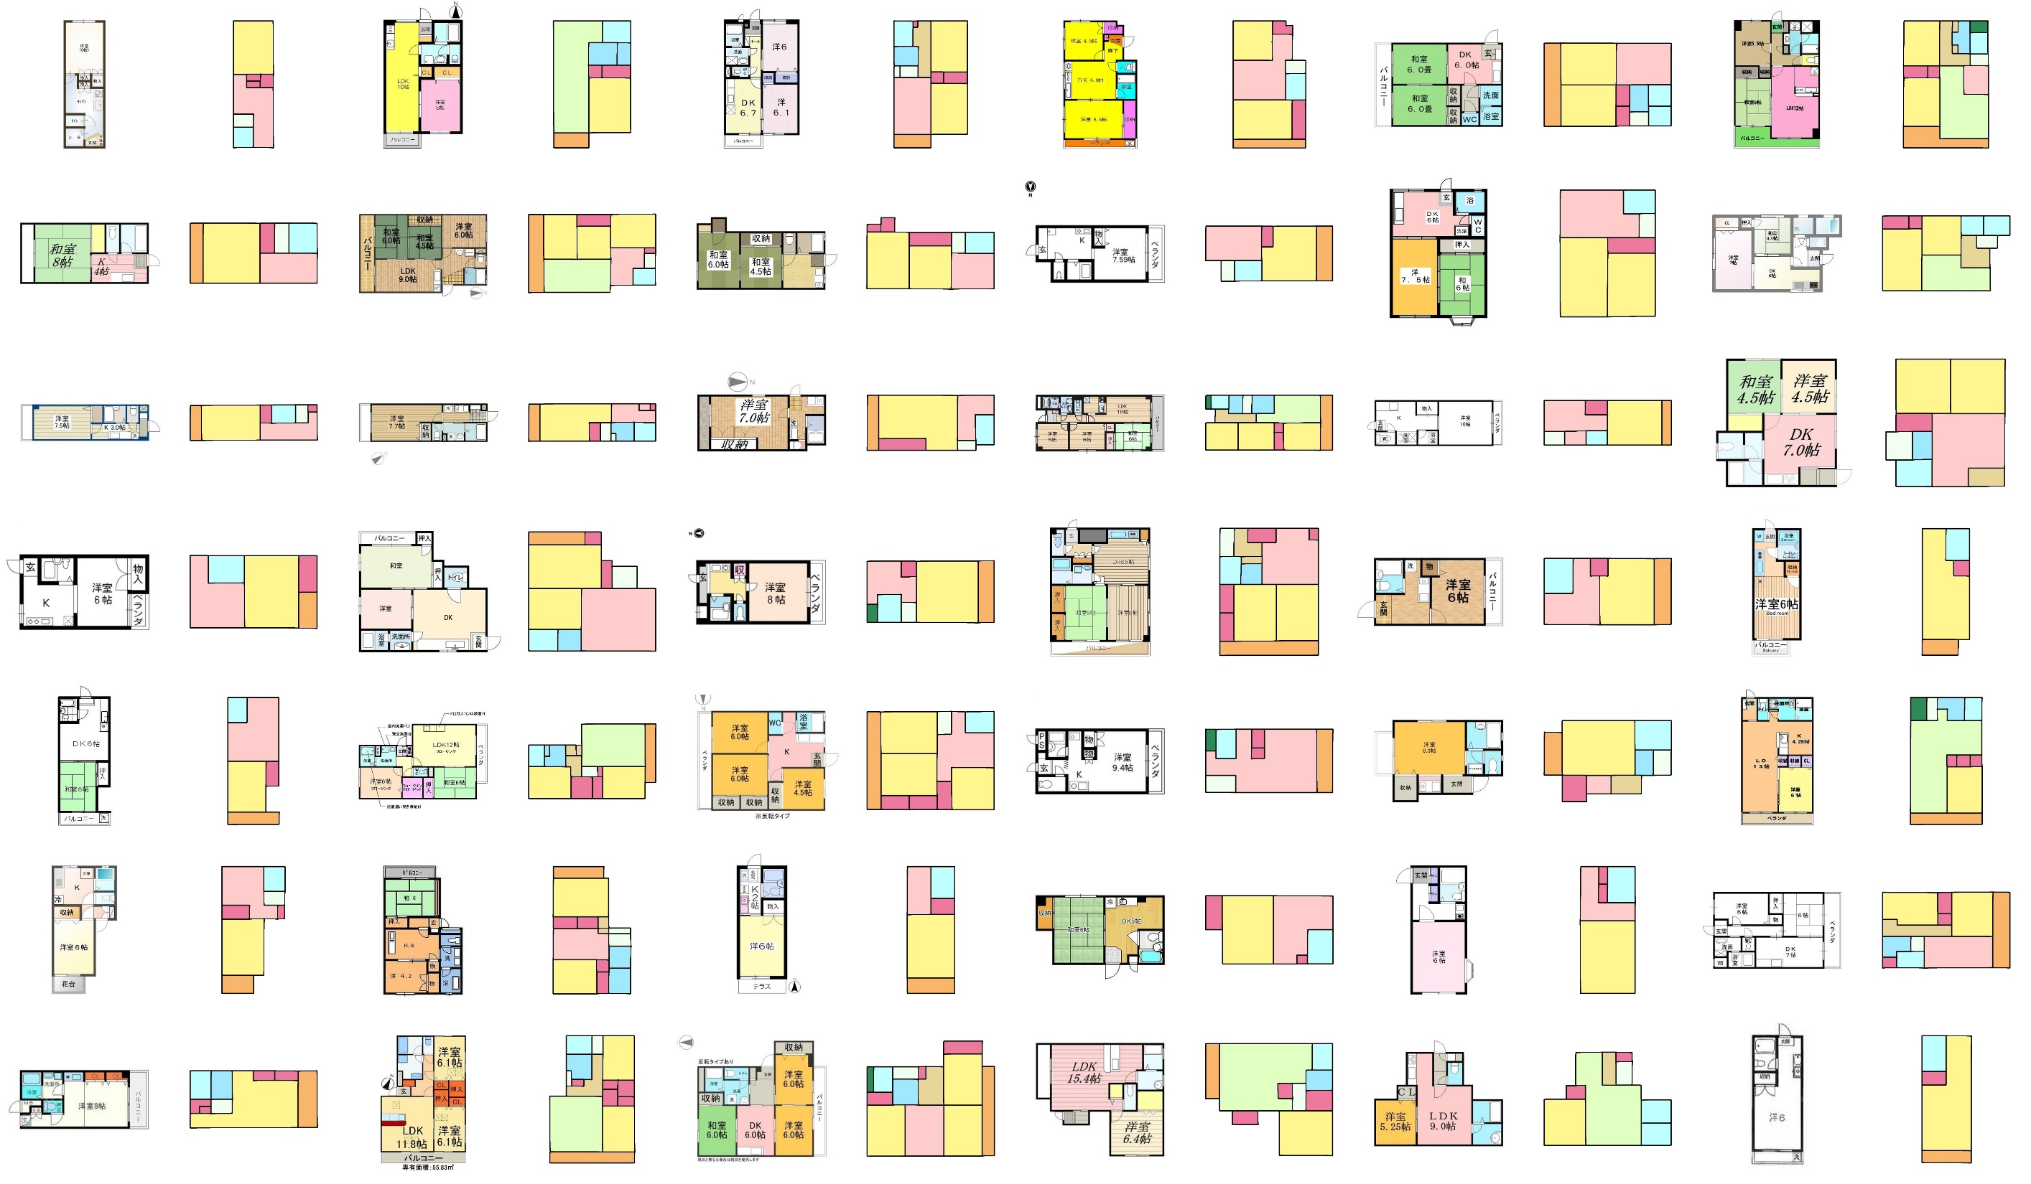

Slide 39
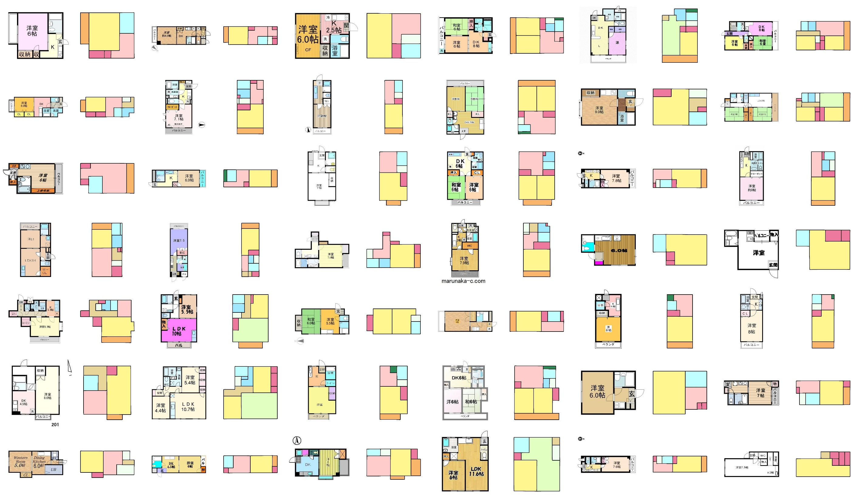

Slide 40
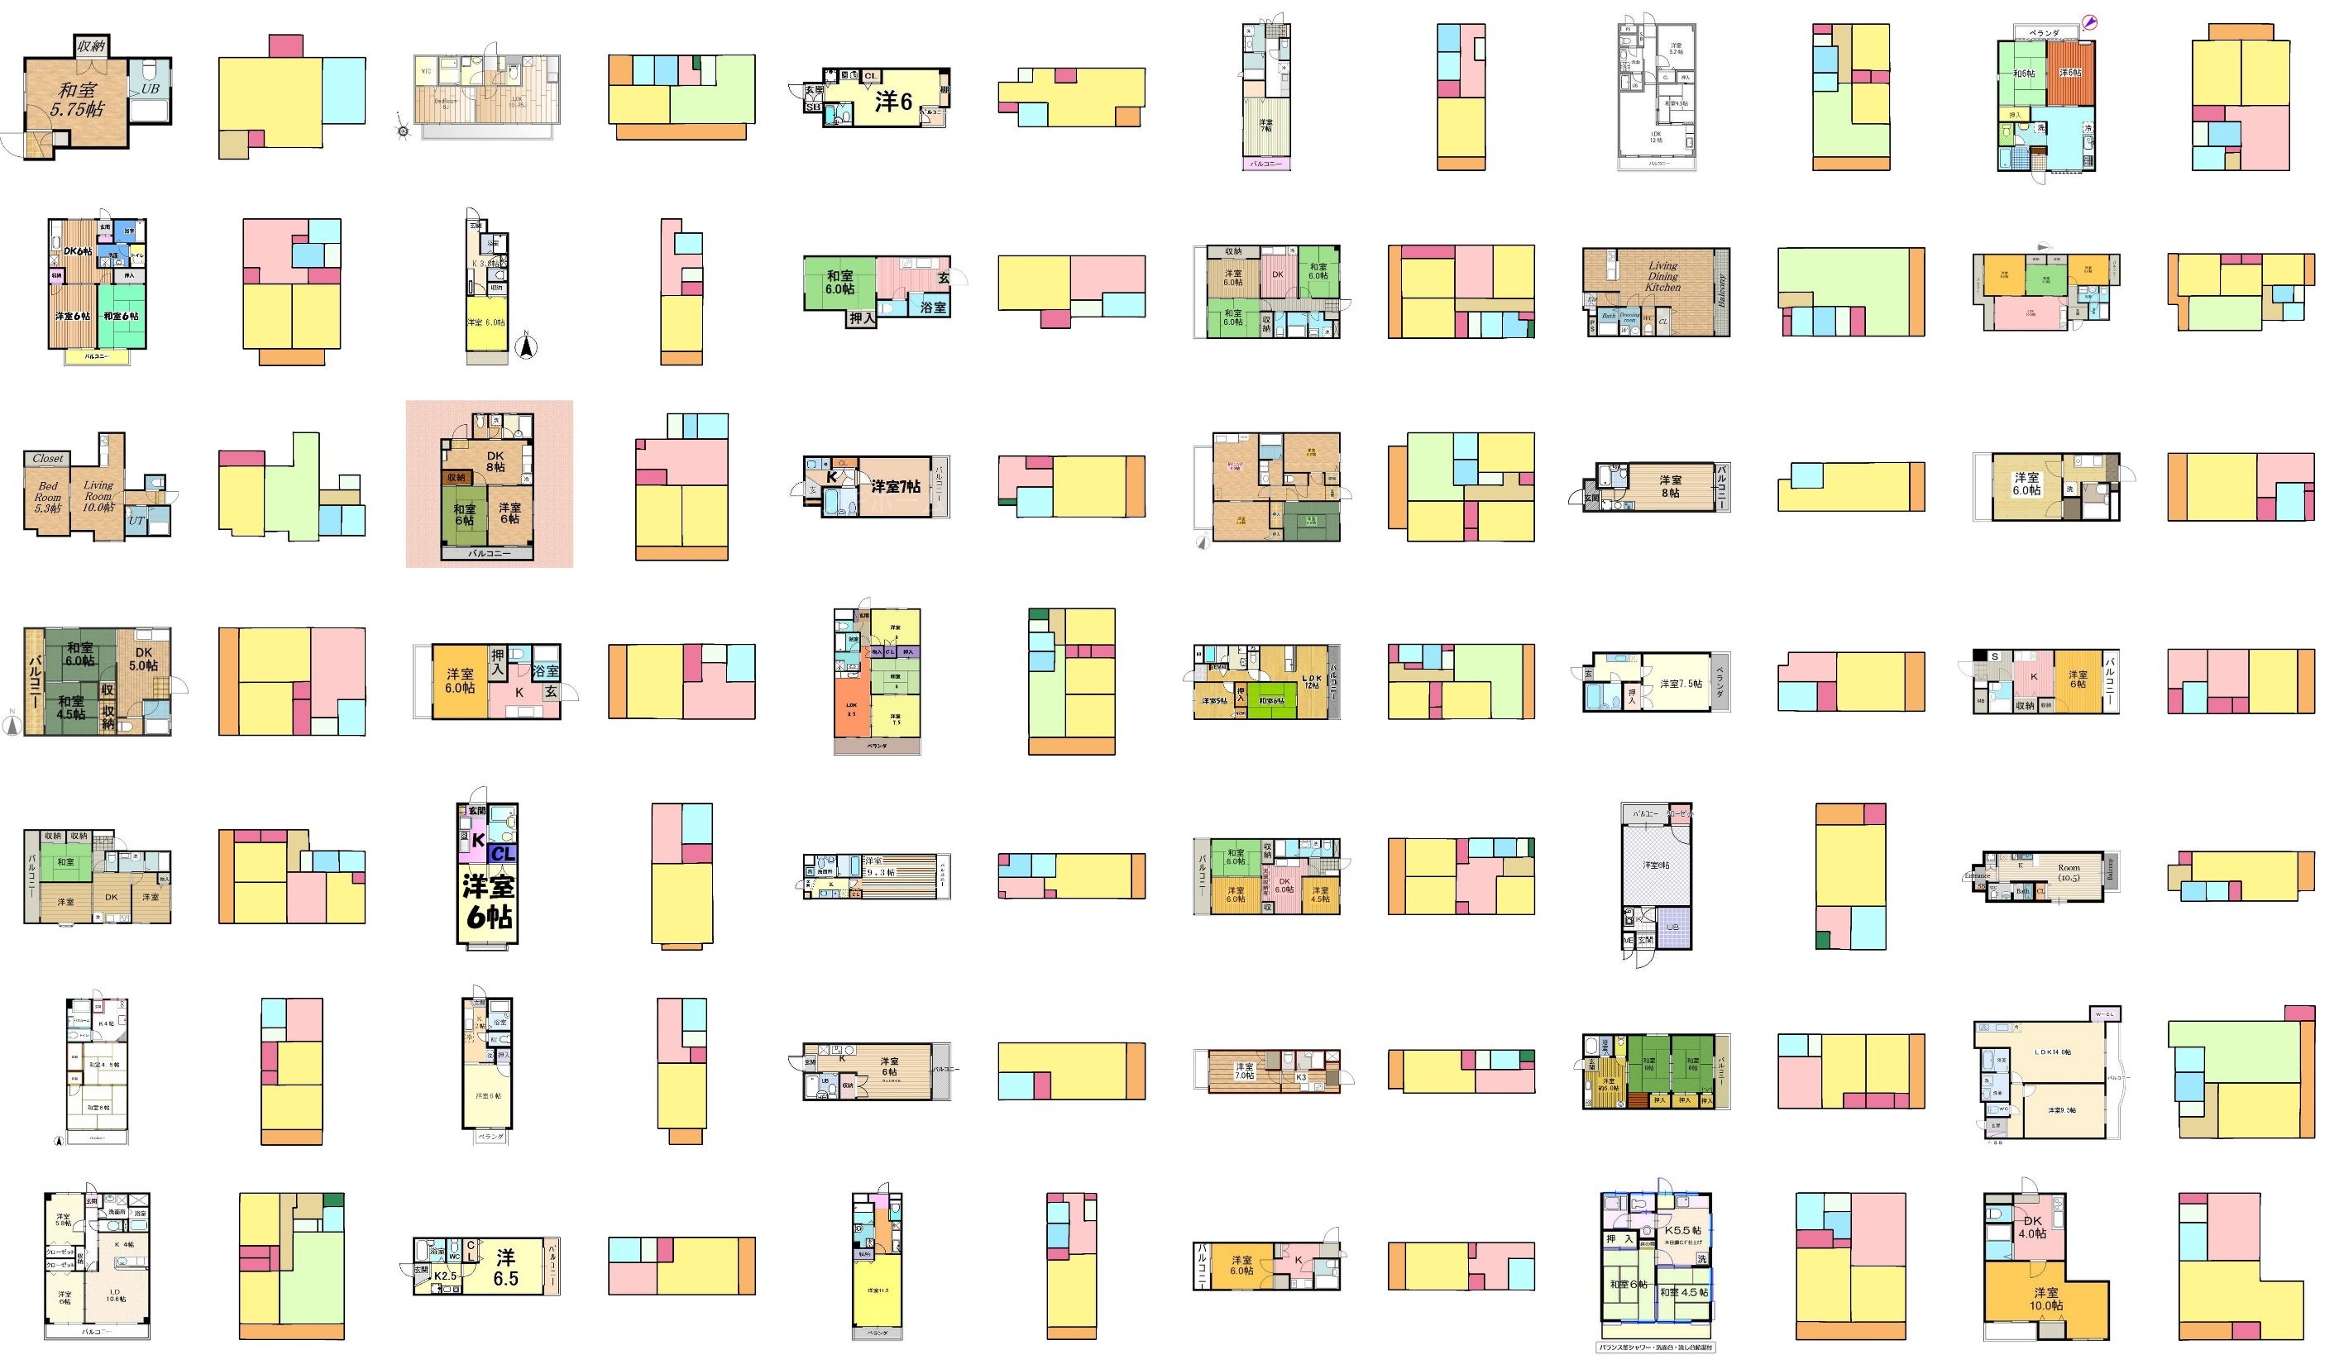

Slide 41
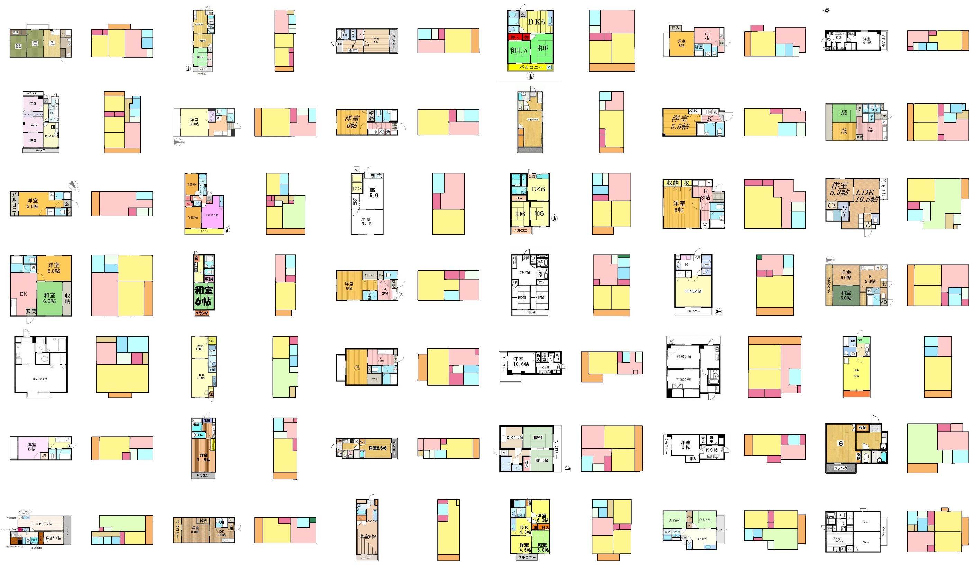

Slide 42
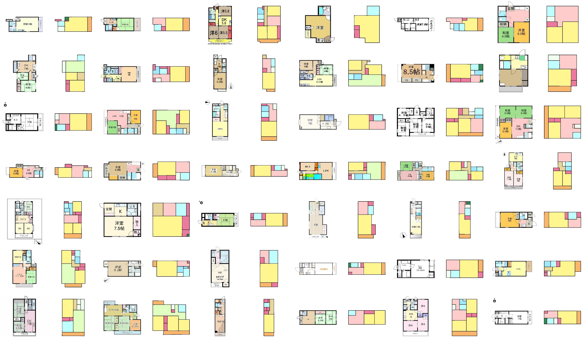

Slide 43
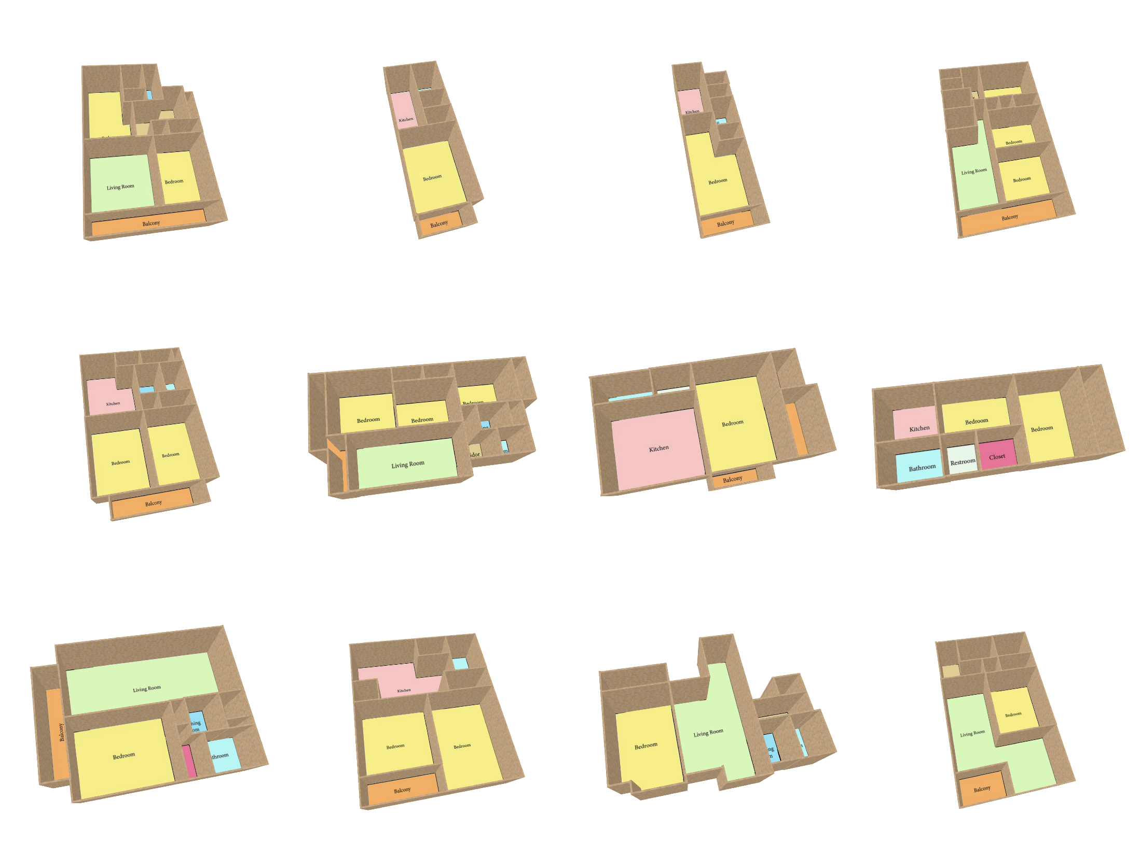
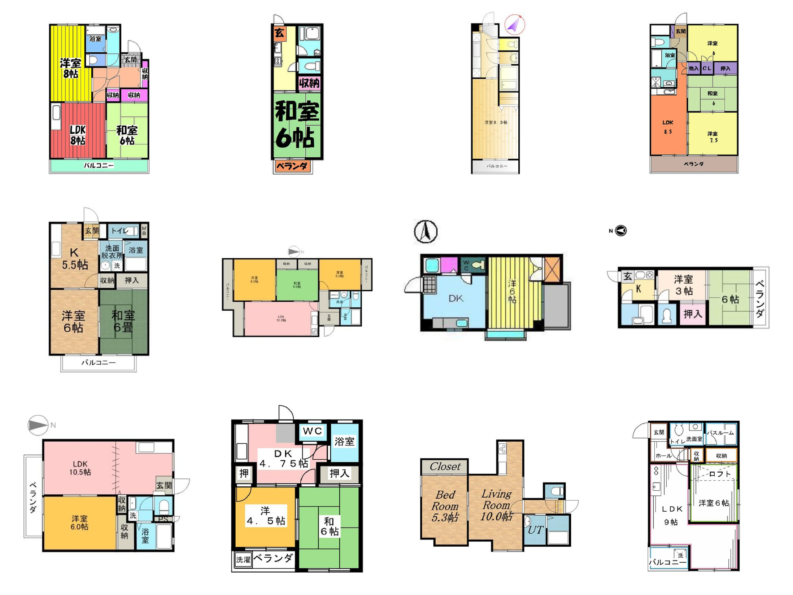
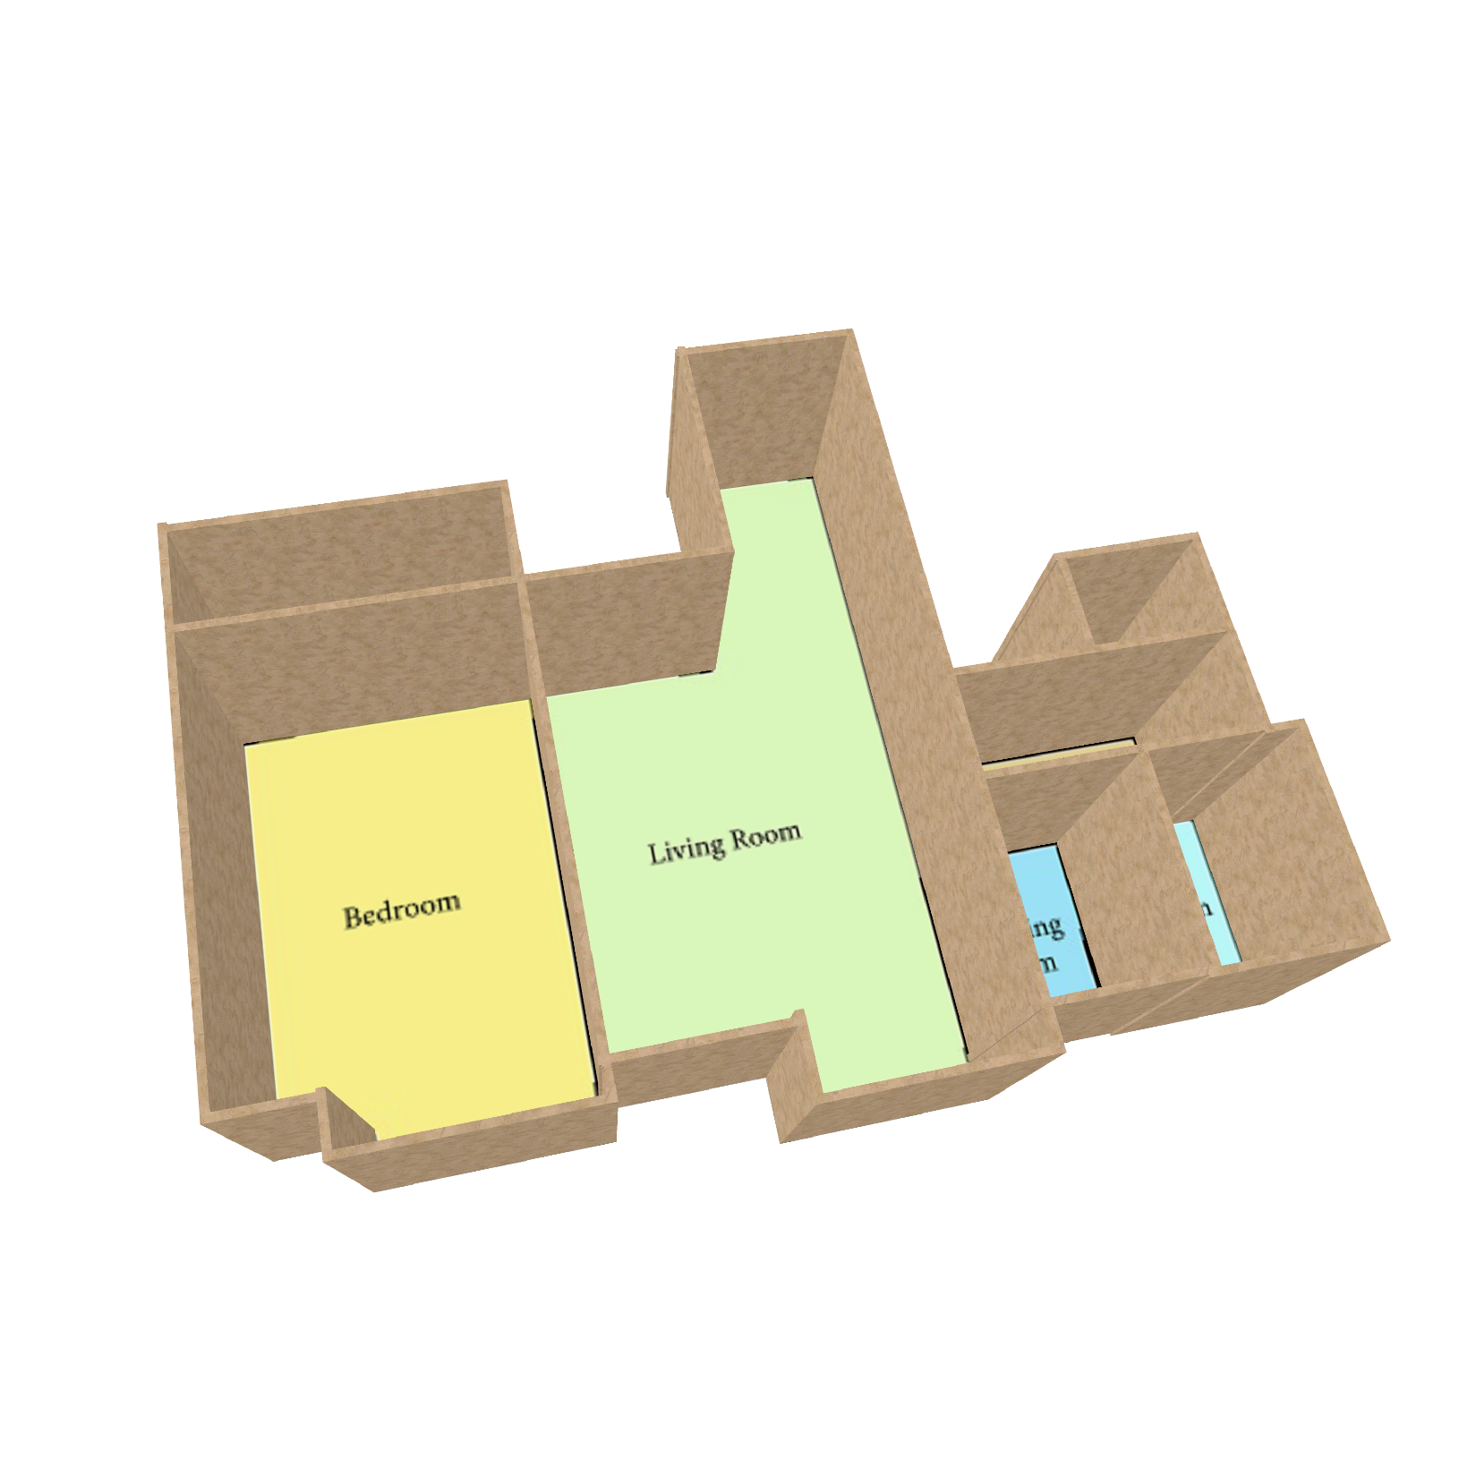
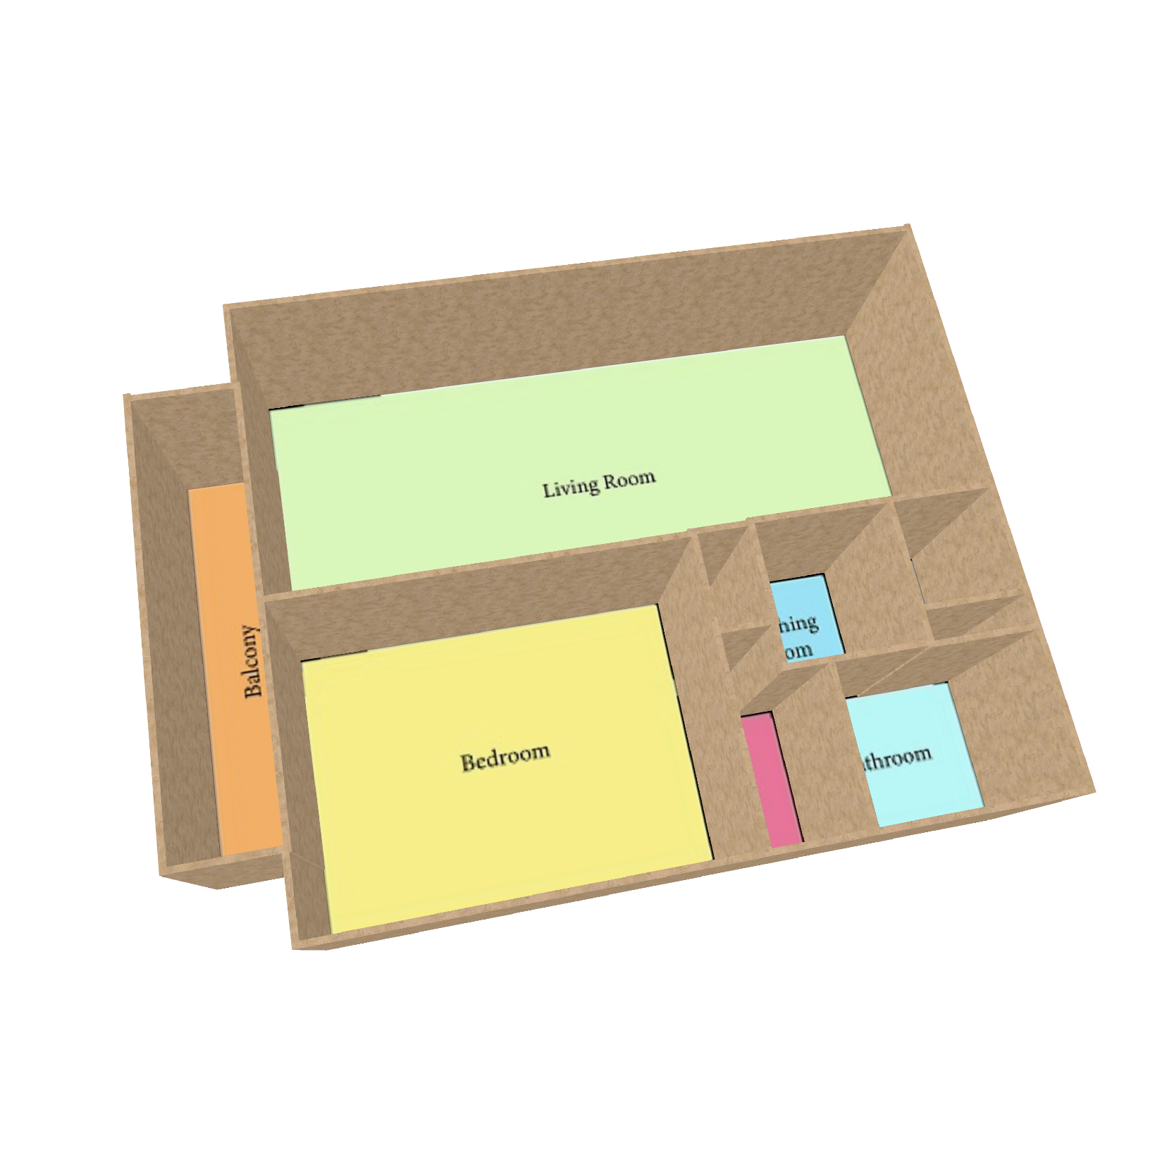
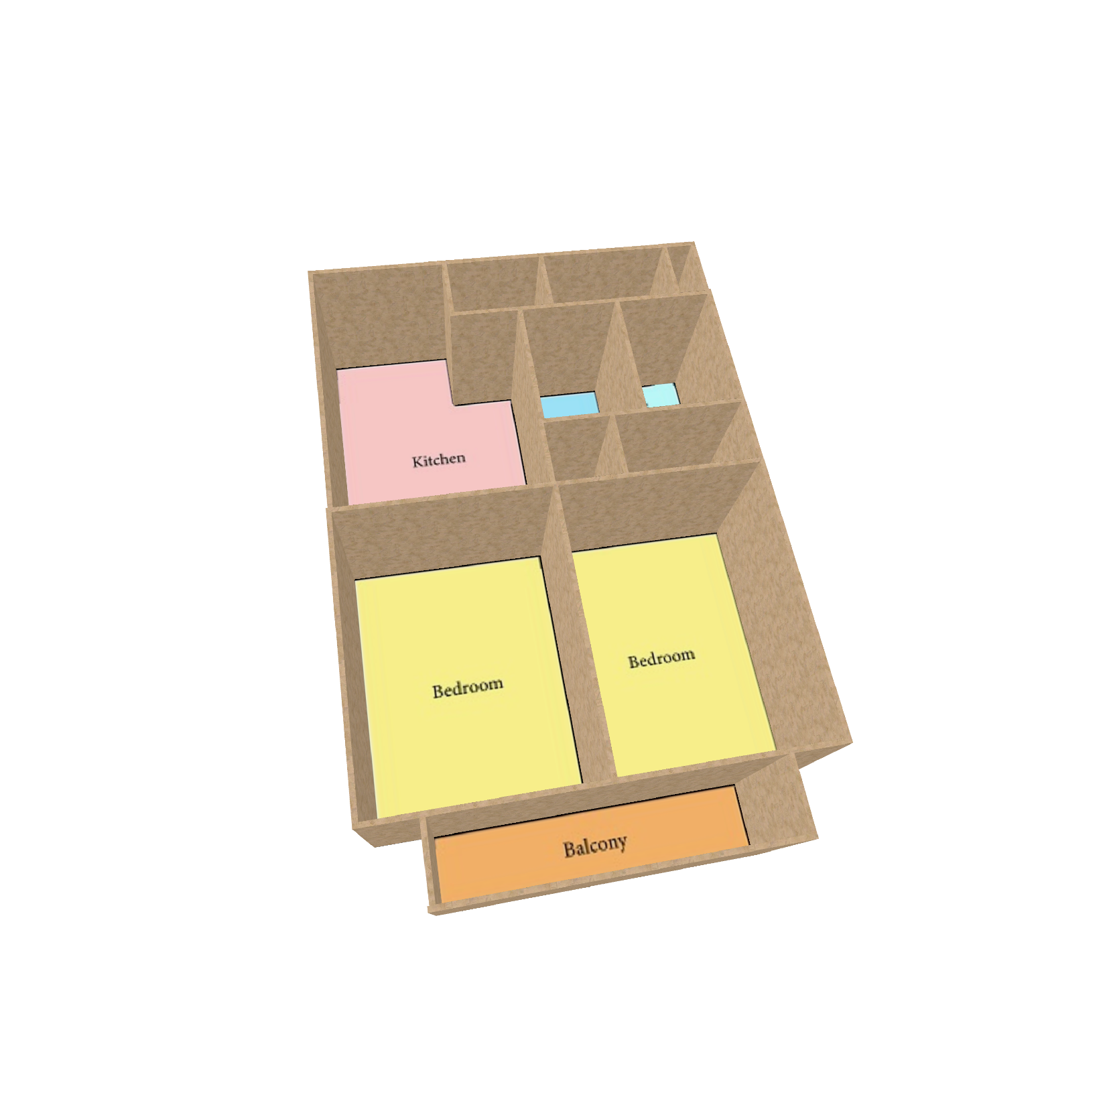
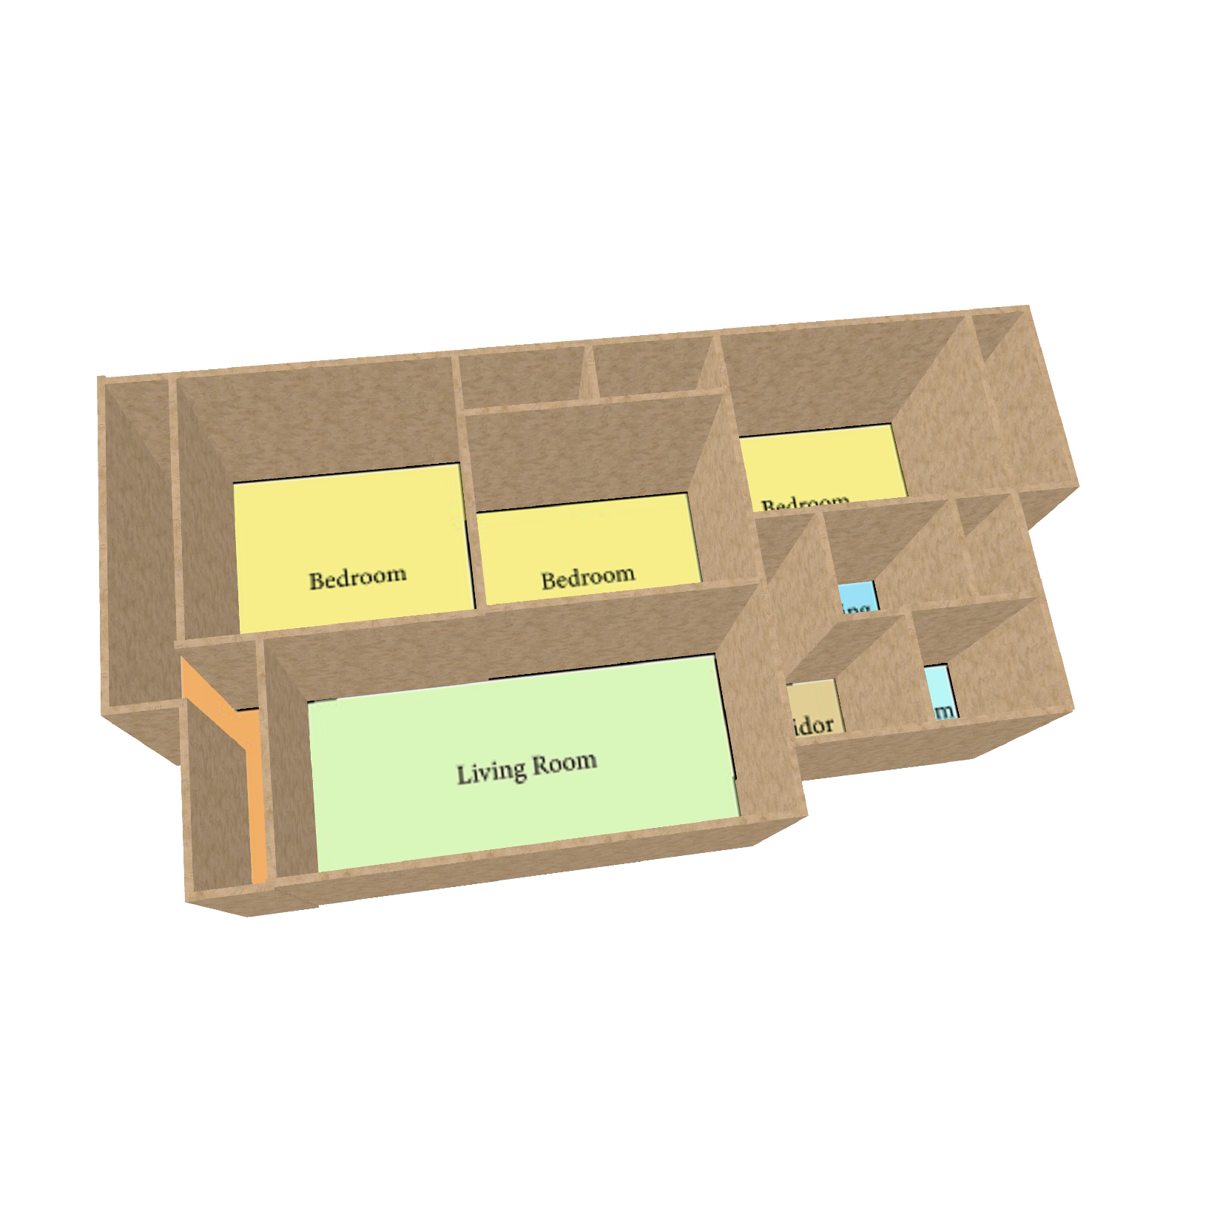
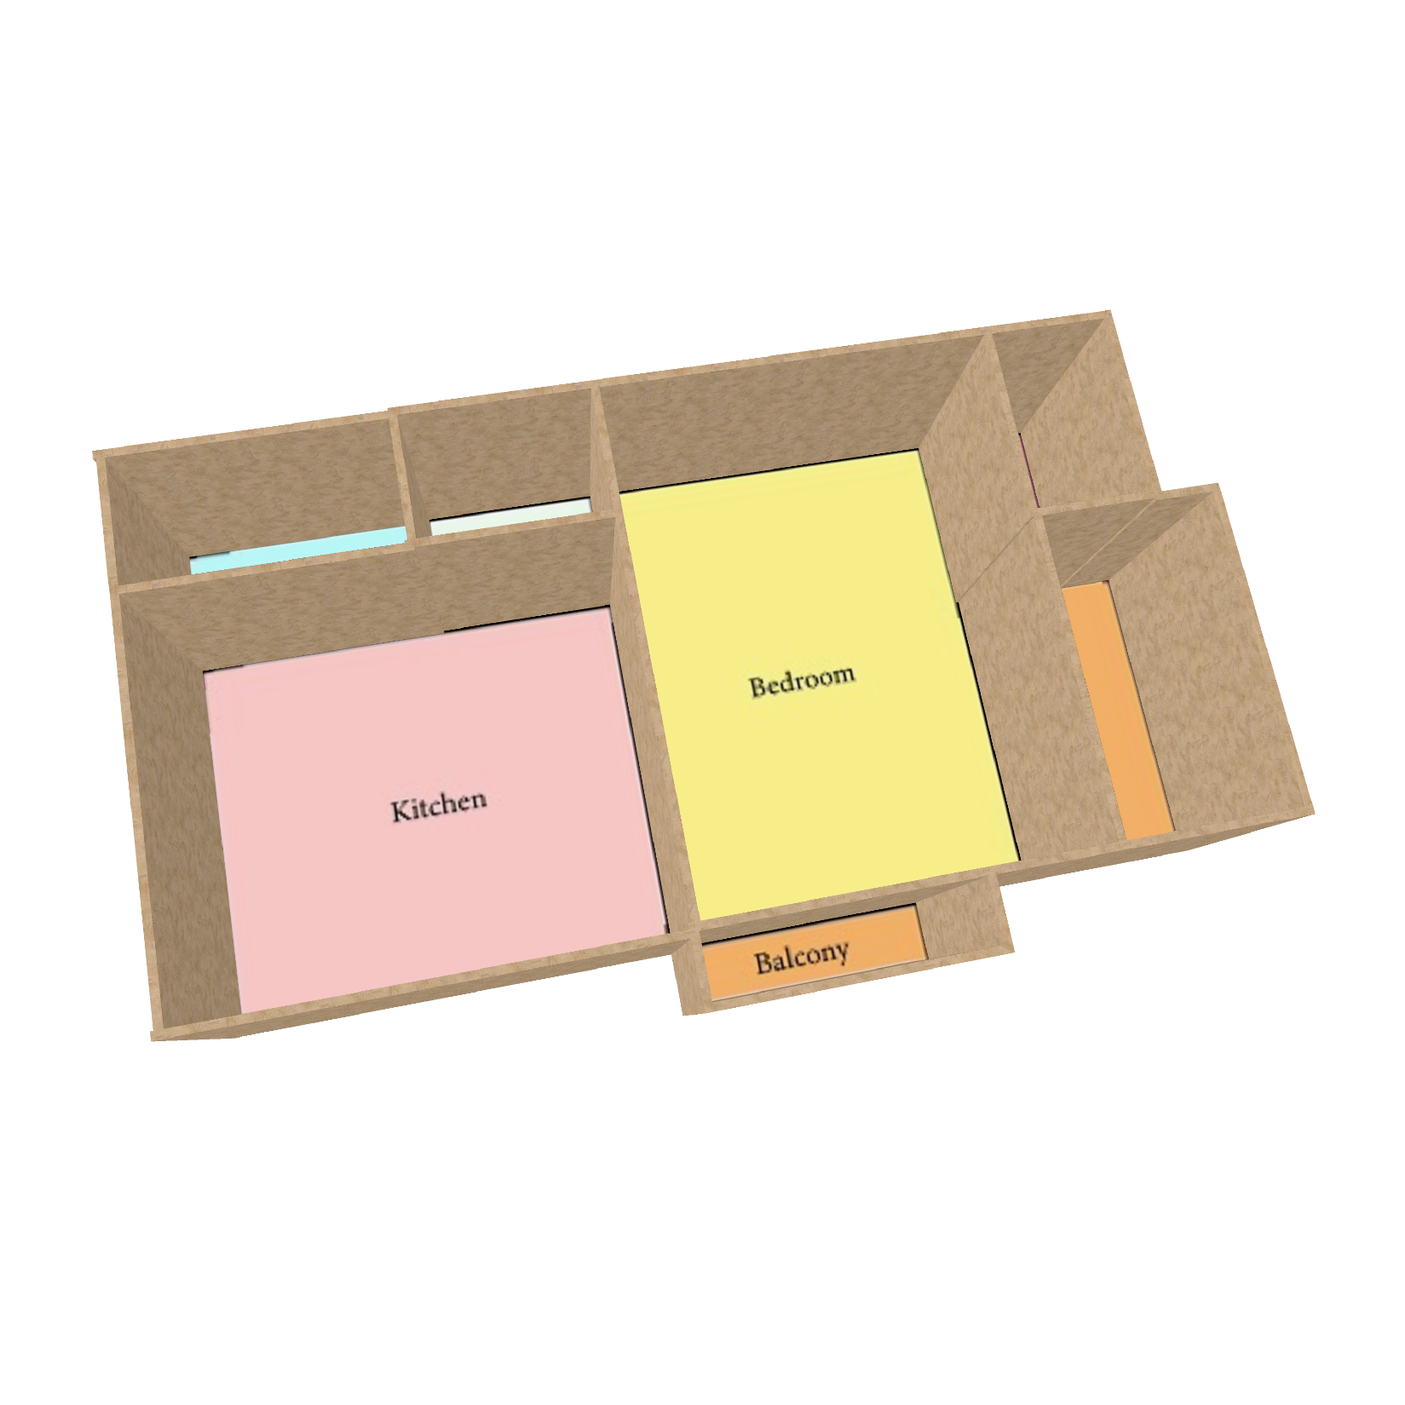
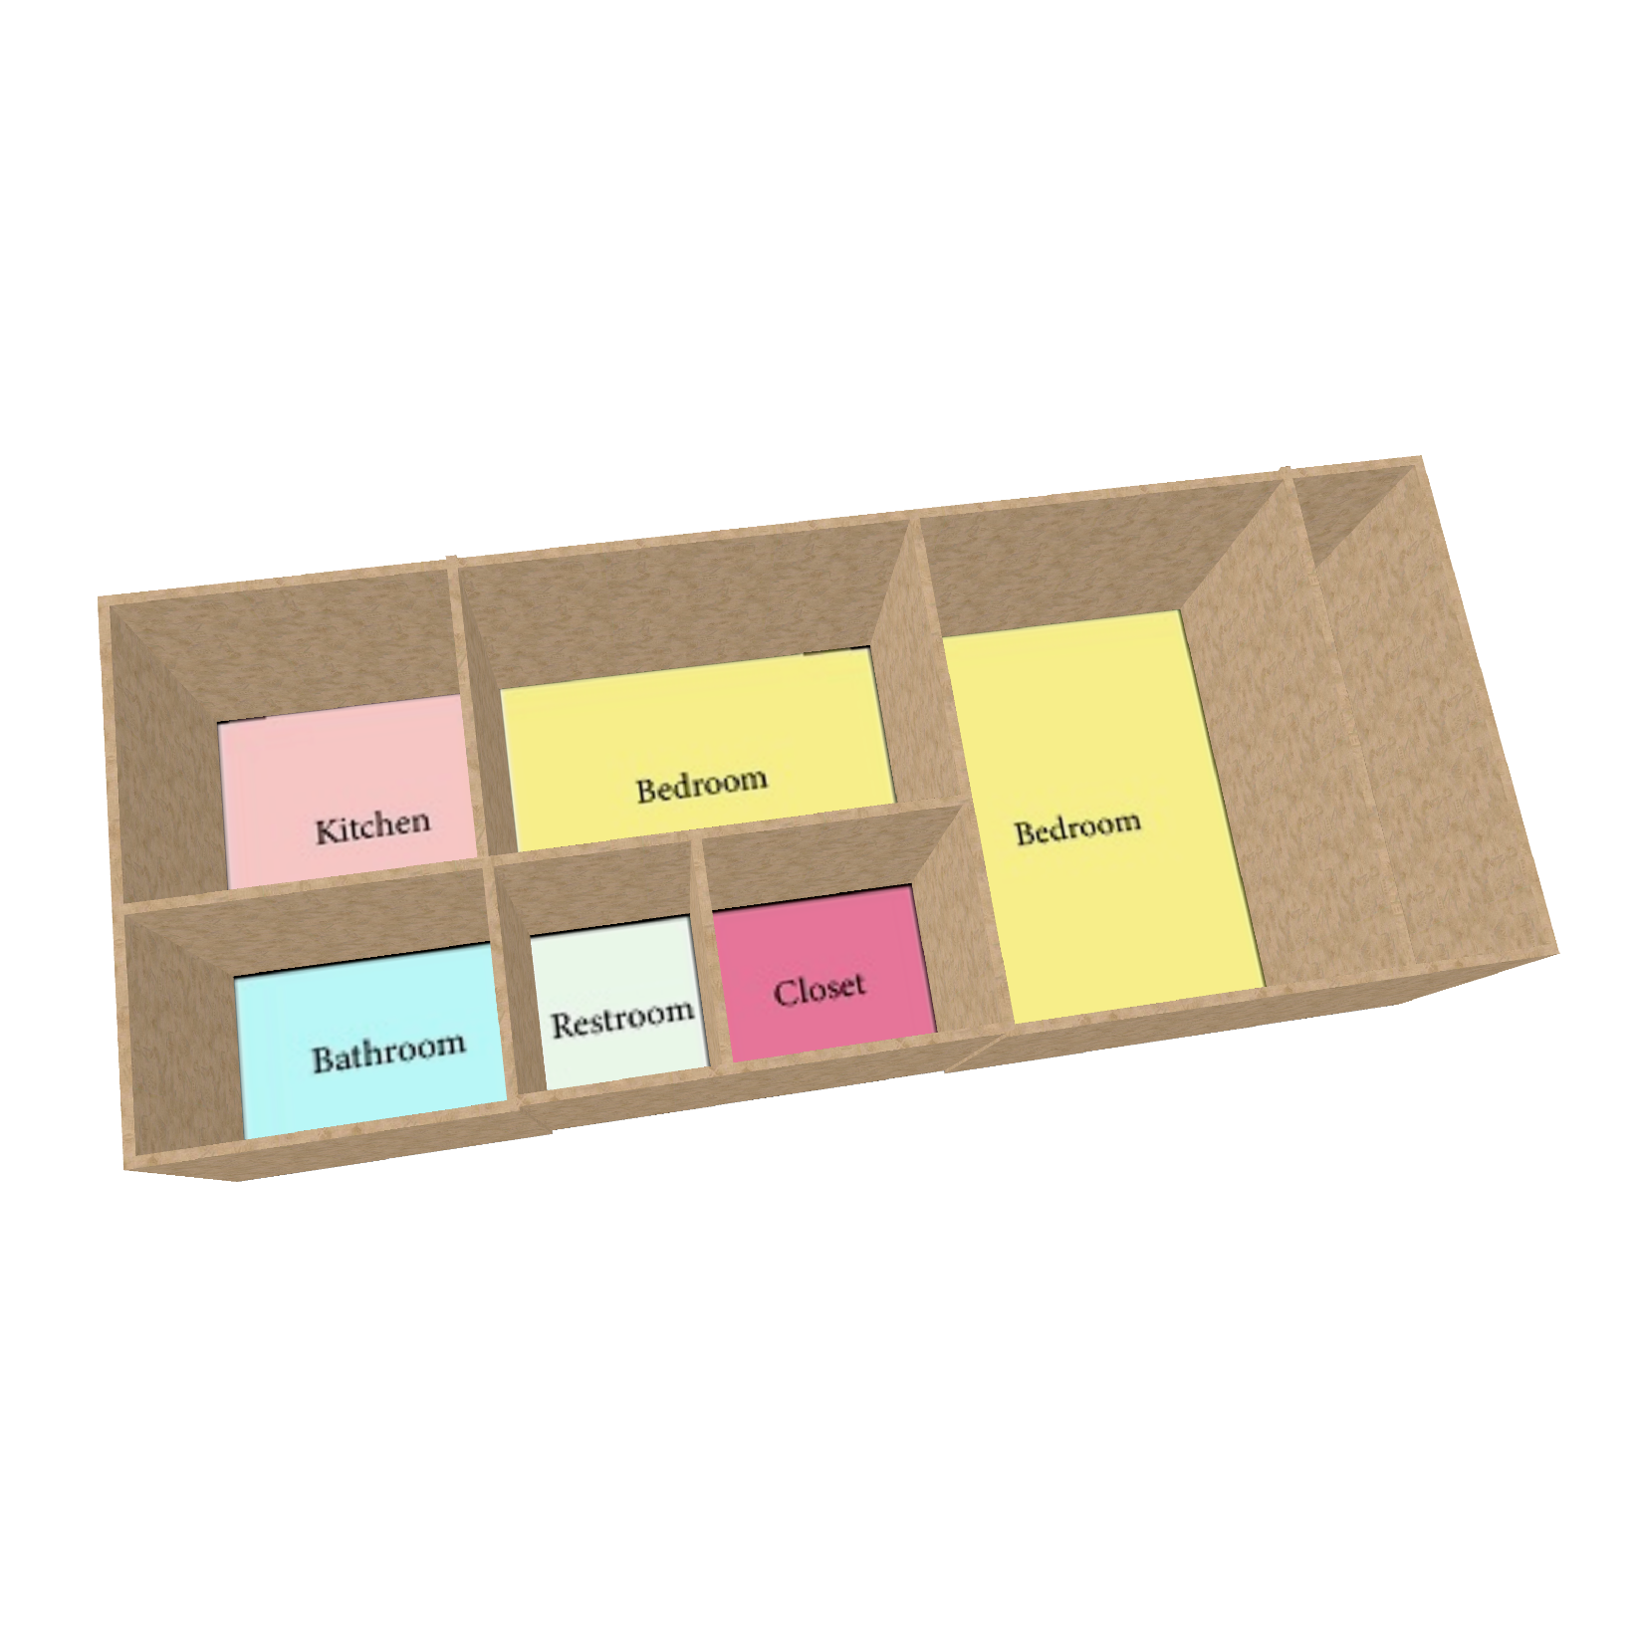
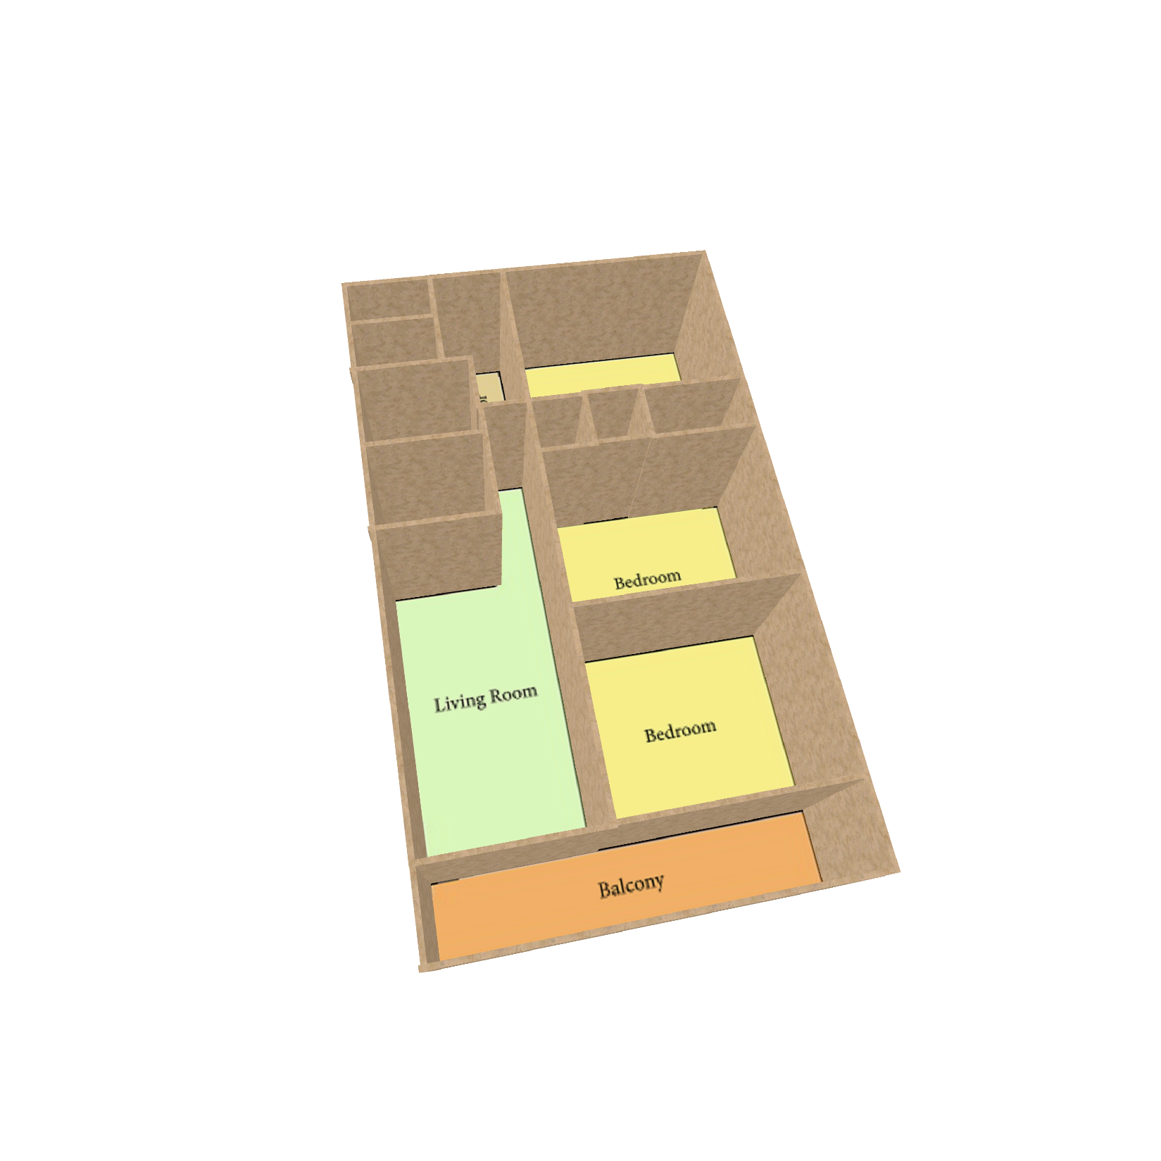
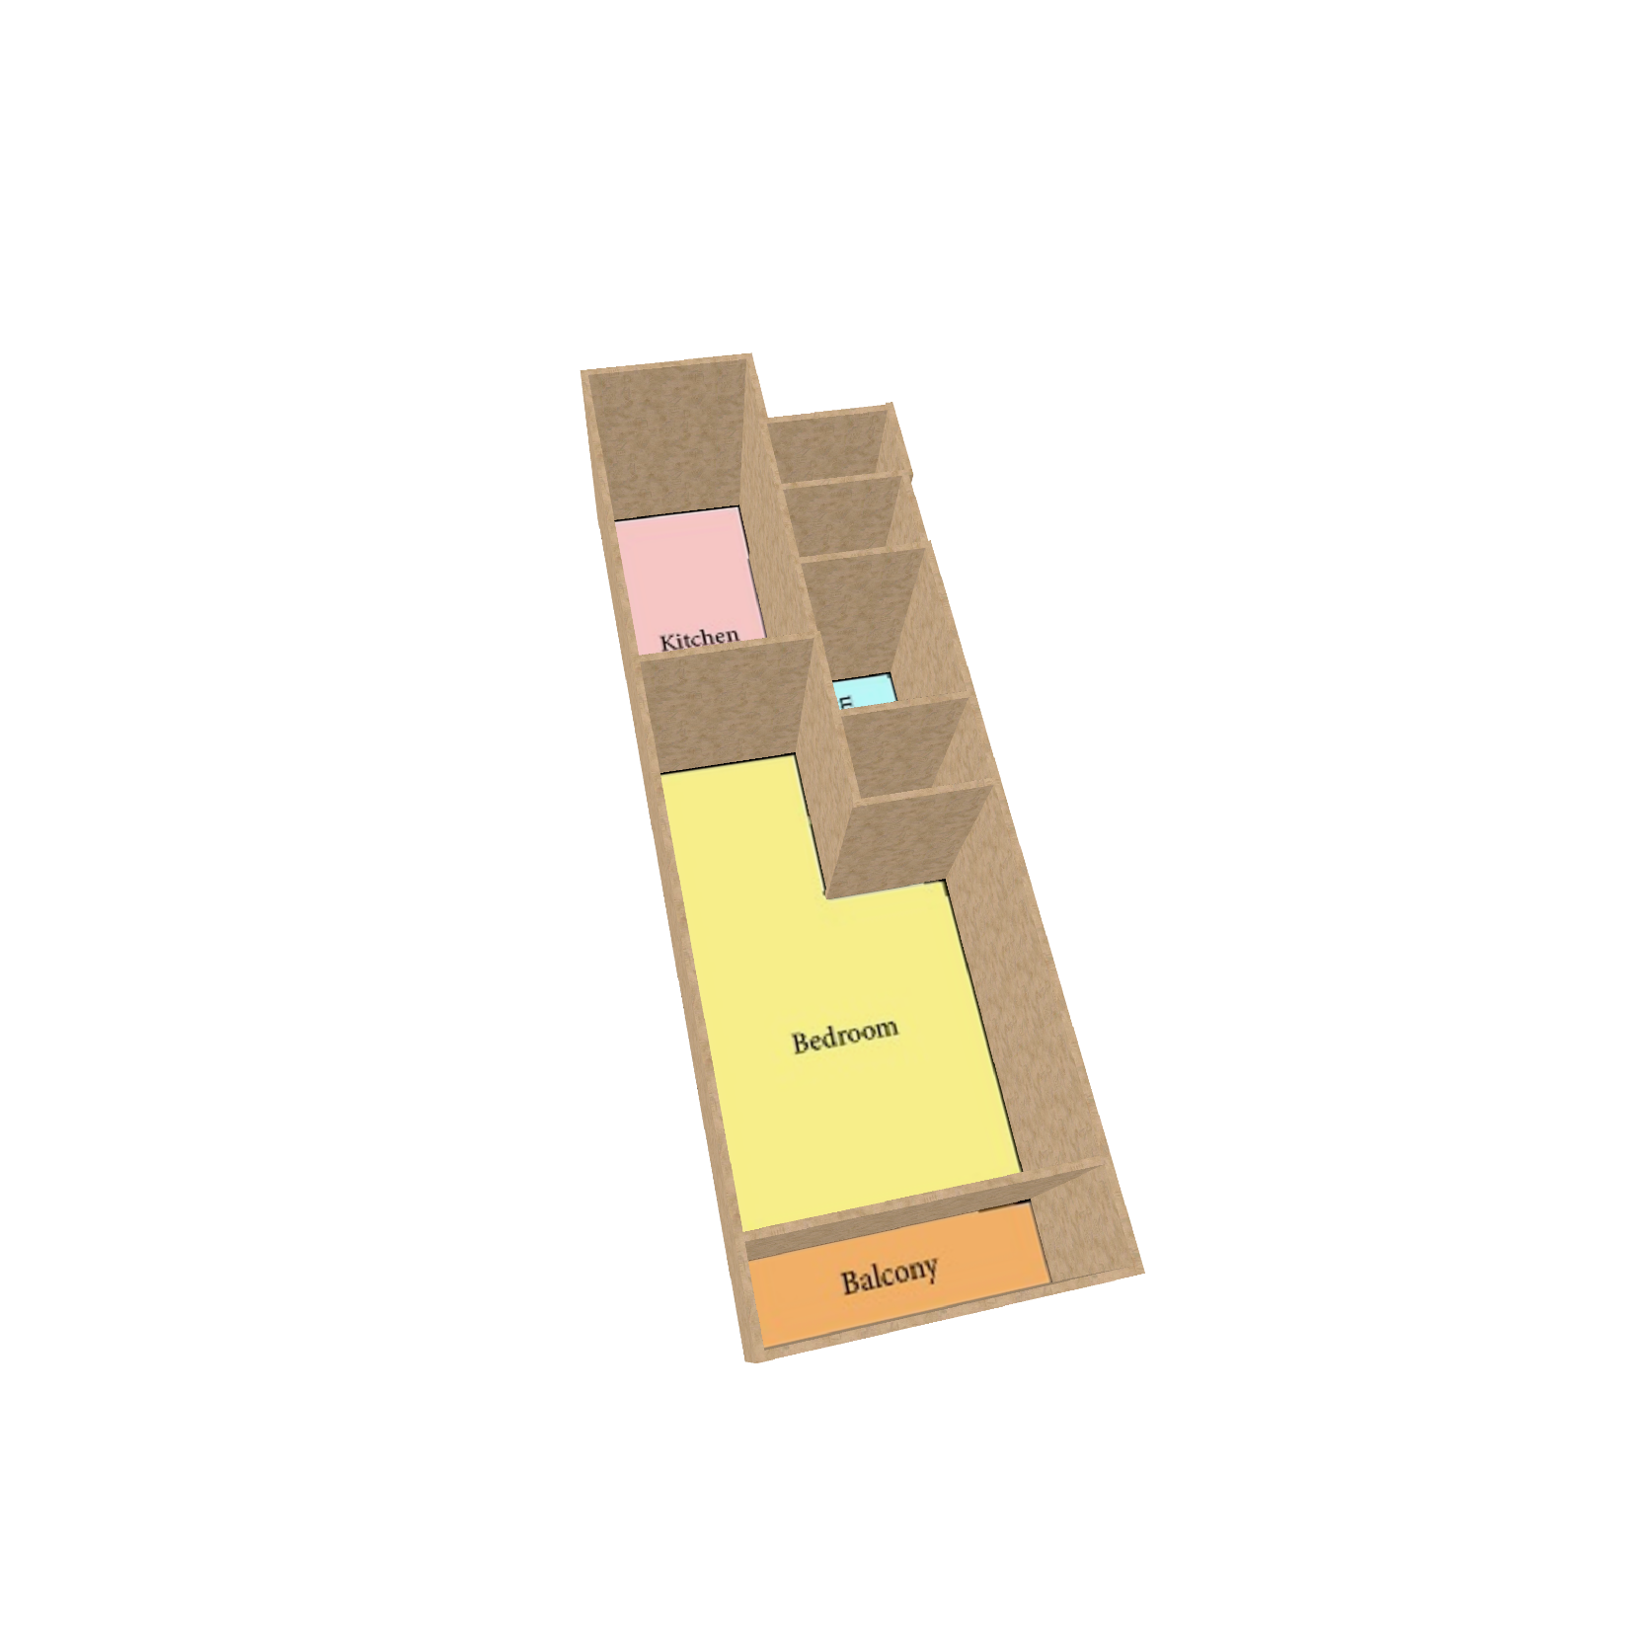
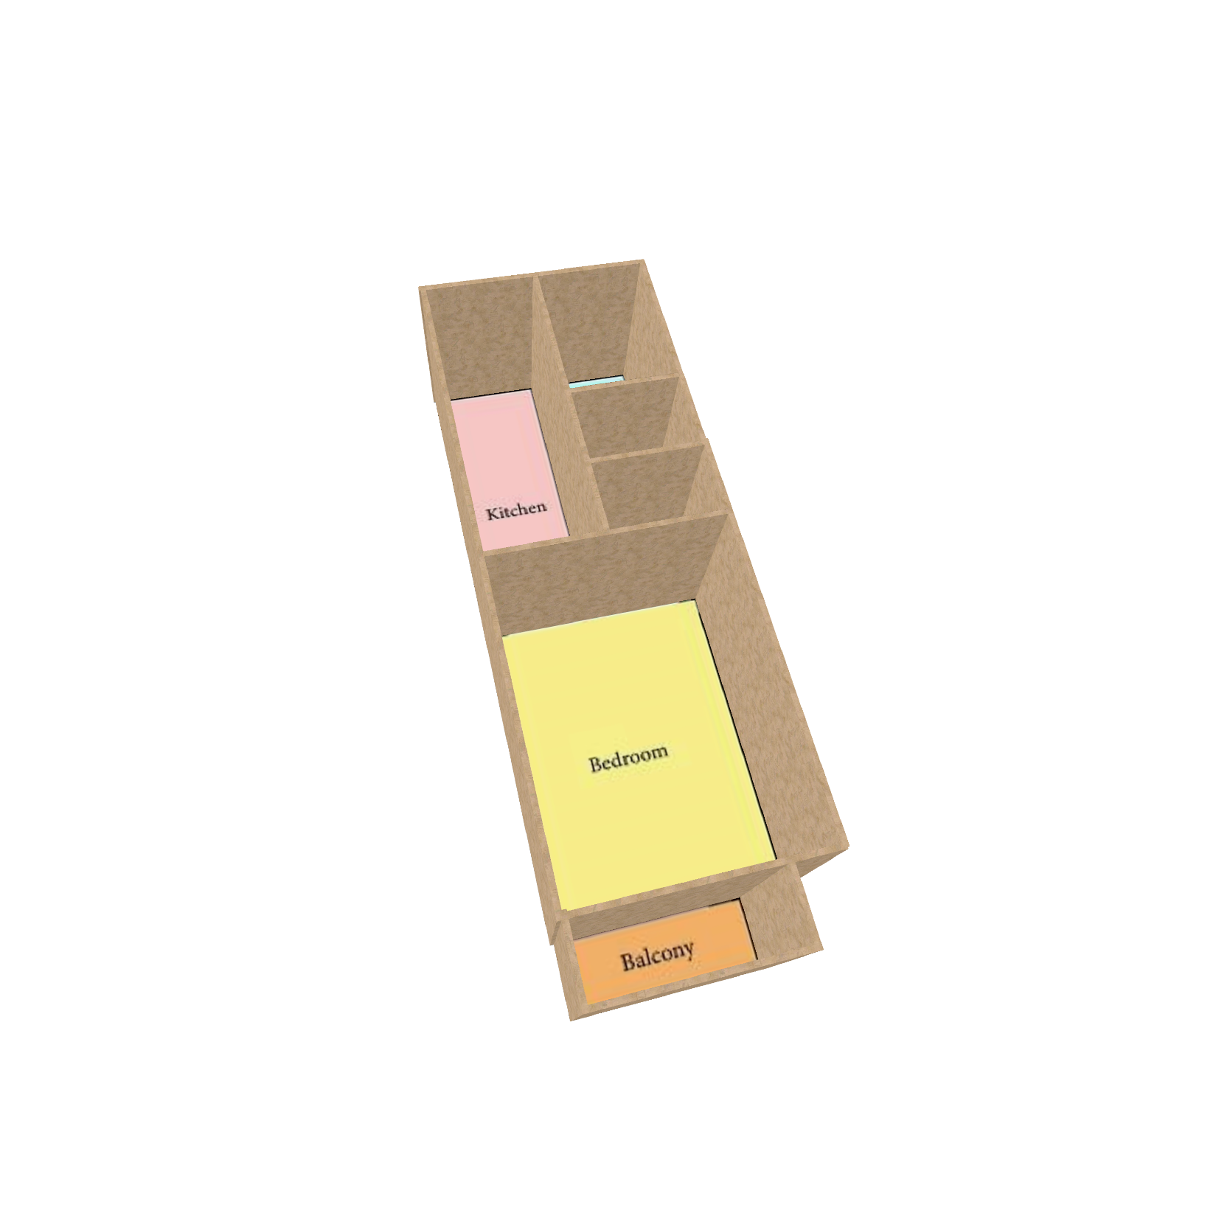
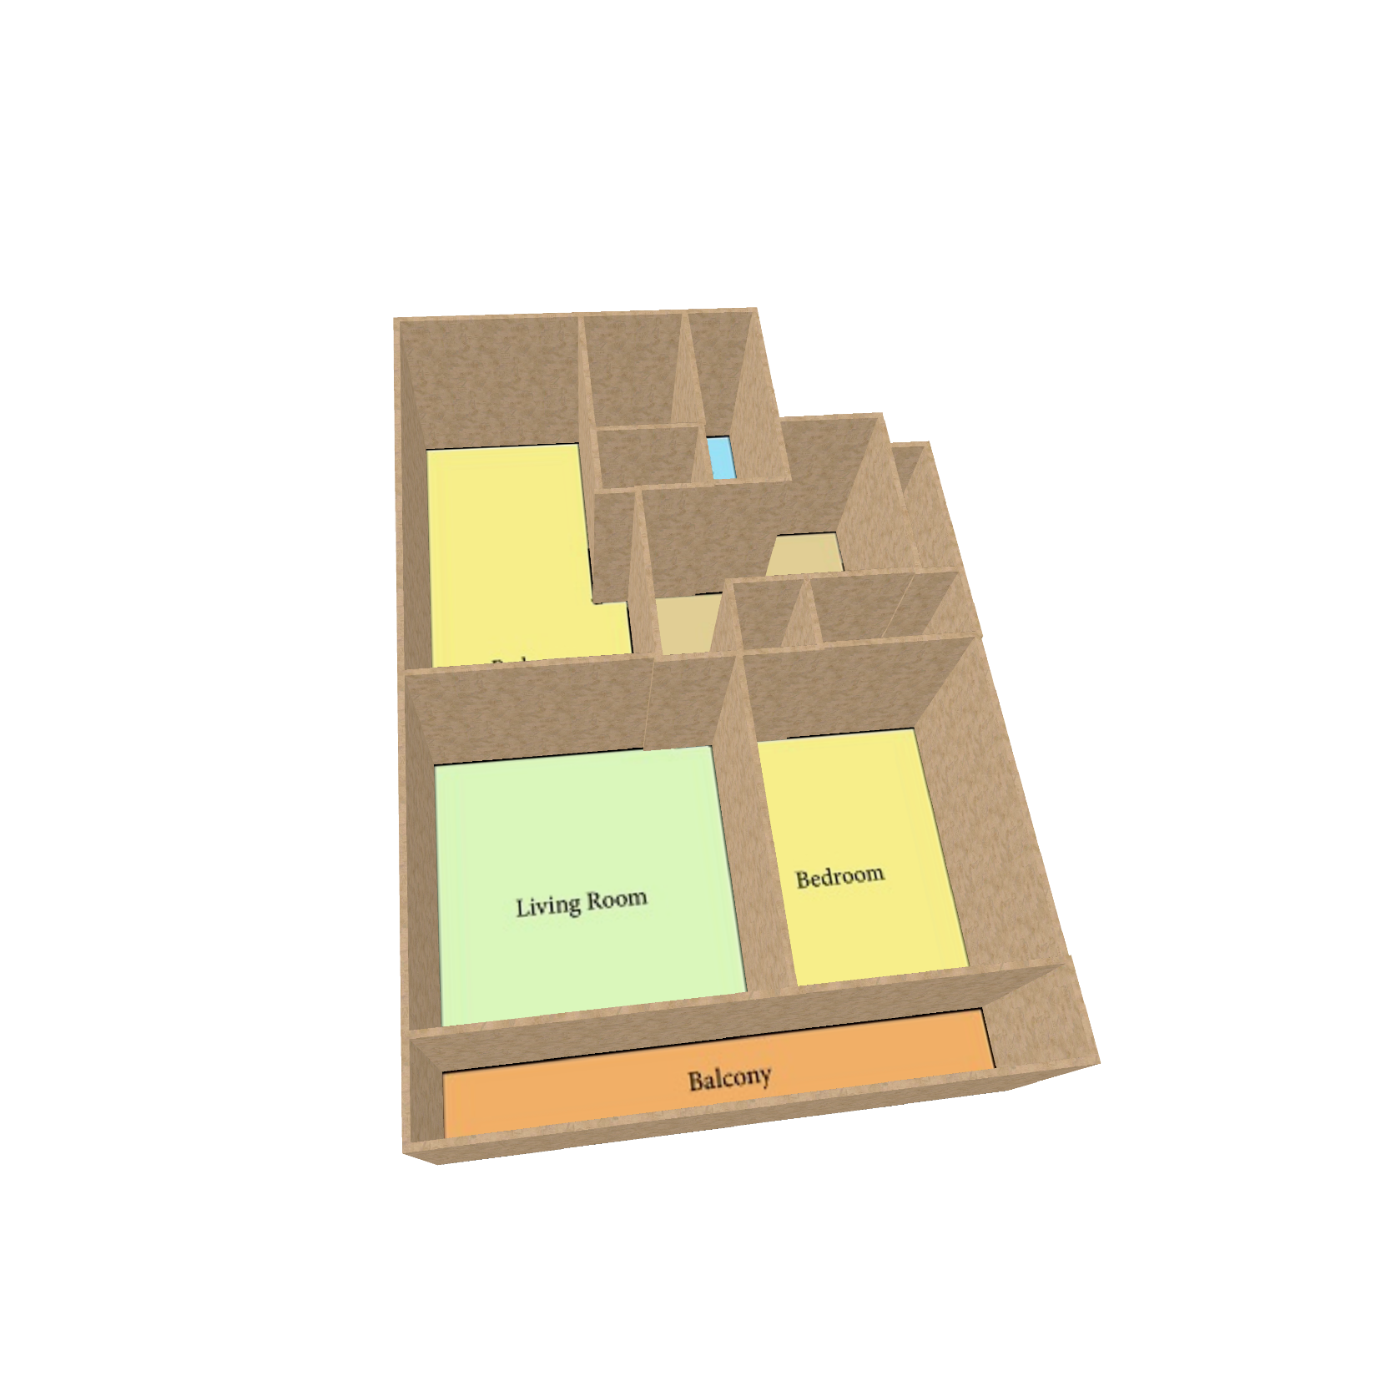
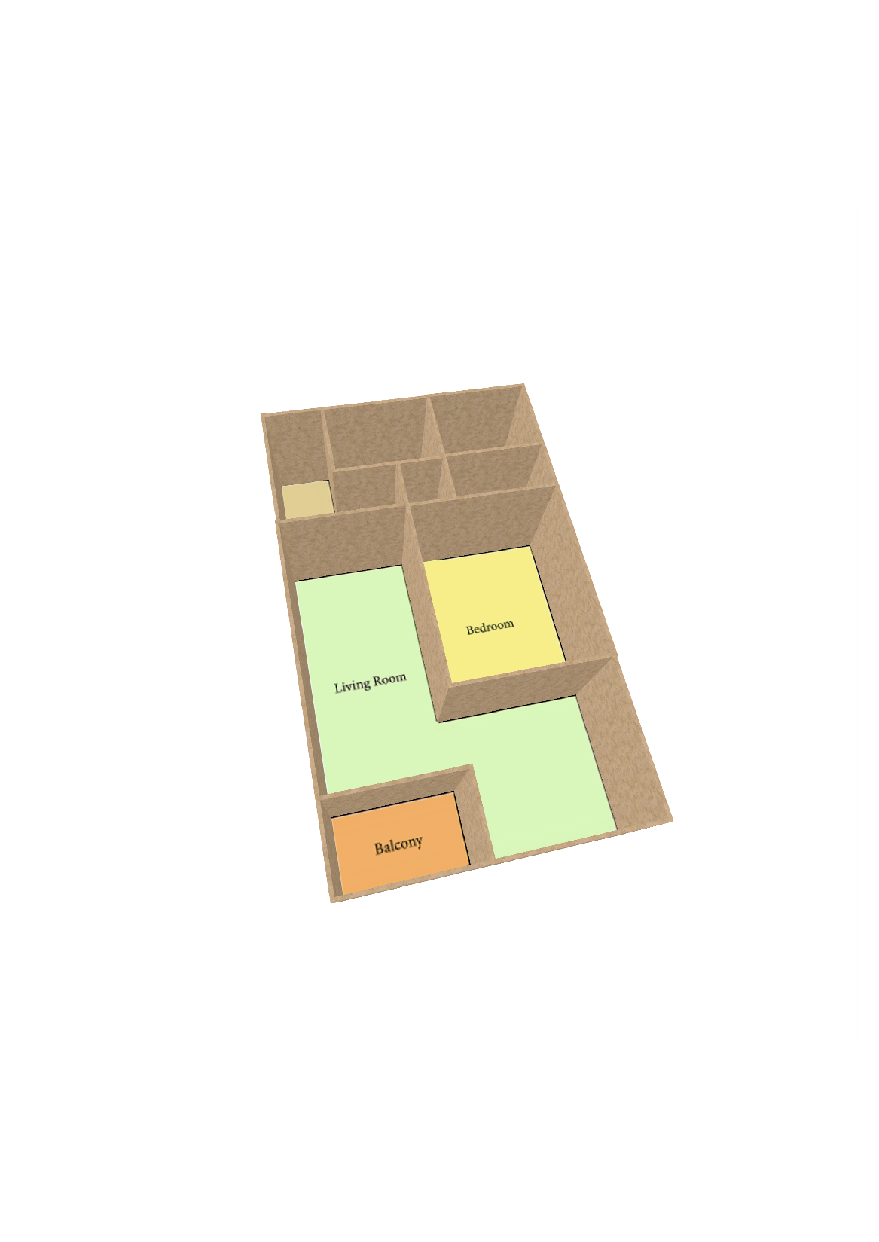
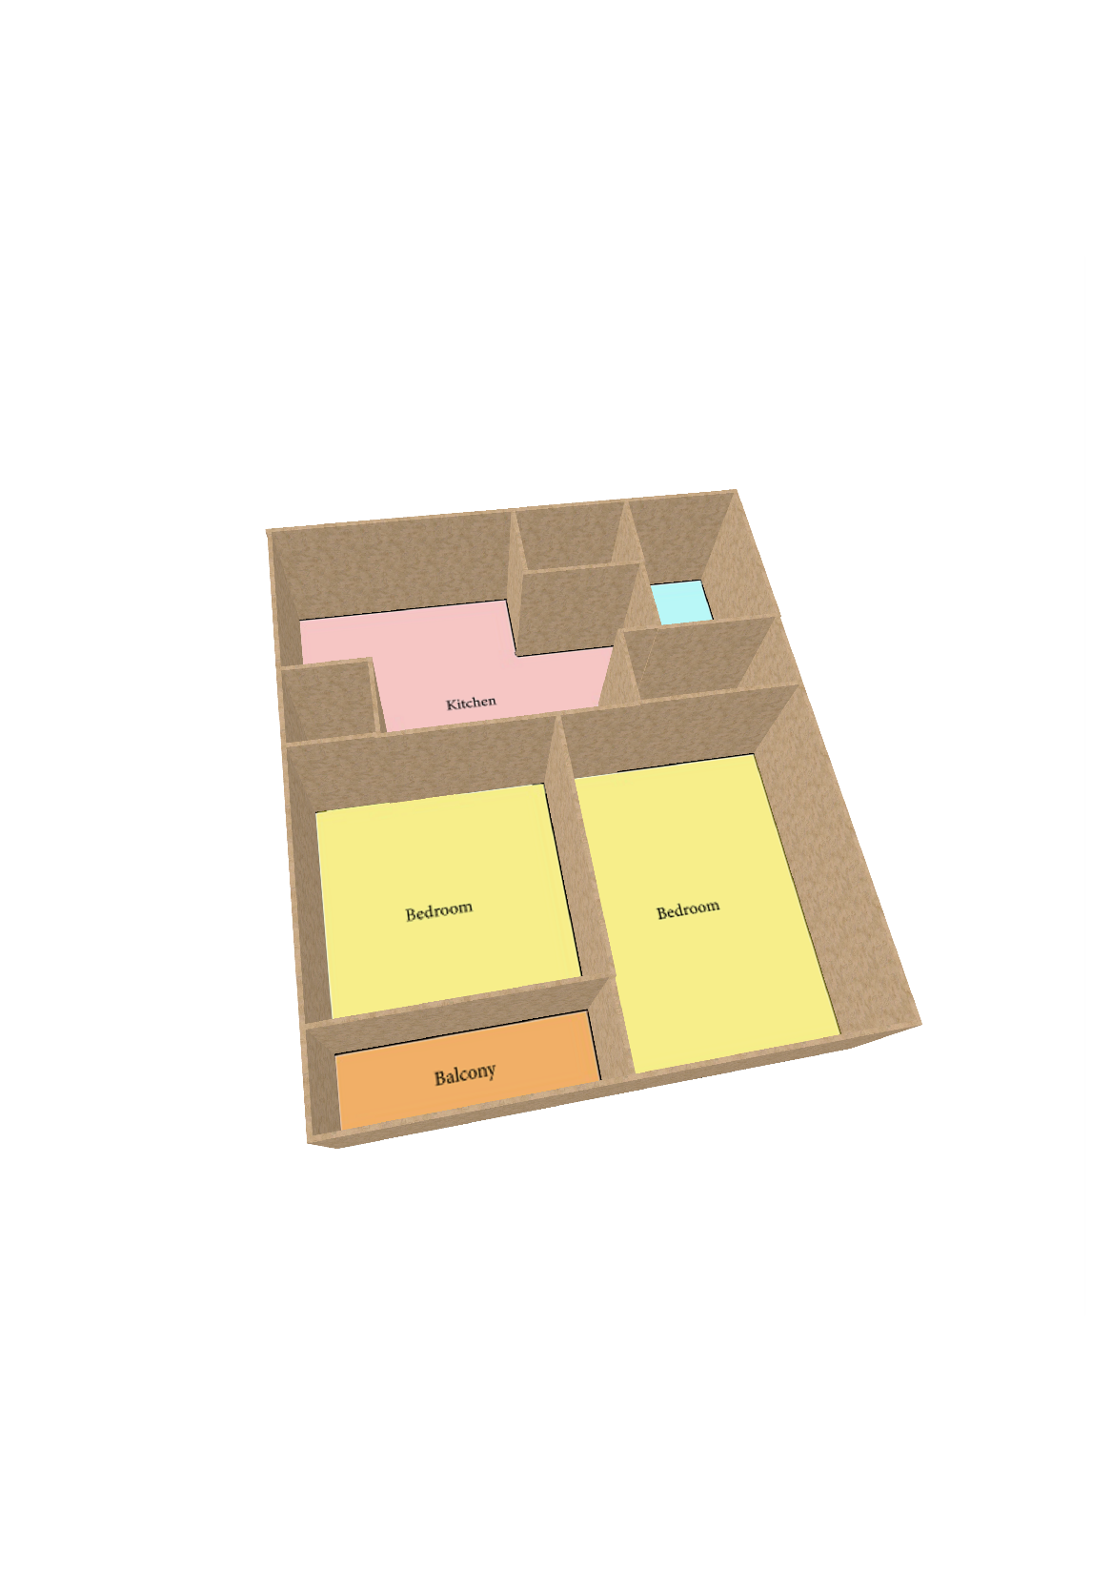

Slide 45
https://github.com/HSZVIS/Raster-to-Graph
https://wutomwu.github.io/particulars.html?id=5
Sizhe Hu: 2021111117@mail.hfut.edu.cn
Wenming Wu: wwming@hfut.edu.cn

